Slide 1
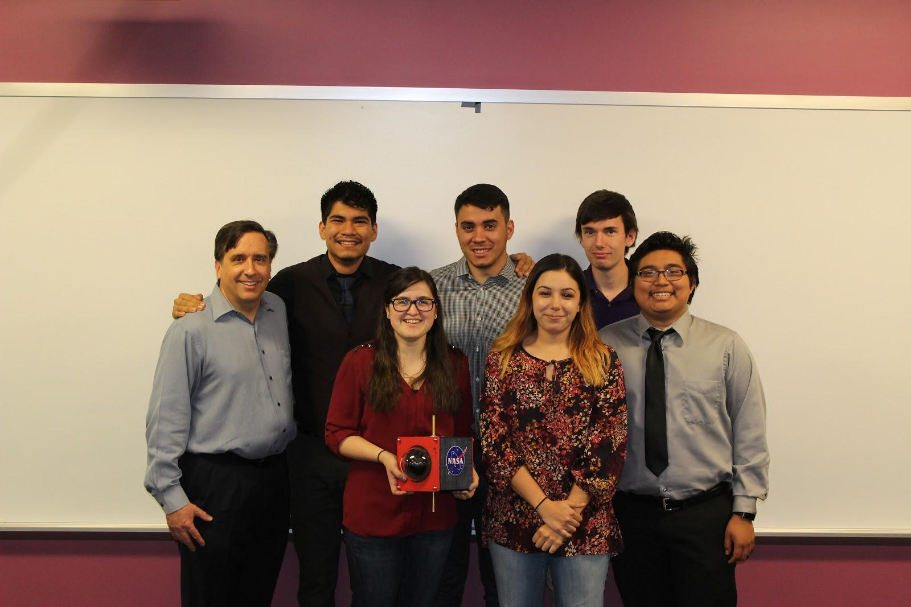
GCC ASCEND
Frank Islas
Miranda Erpelding
Jonathan Wulff
Edwin Guerrero
Nersa Elya
Kennidi Ortega

Slide 2
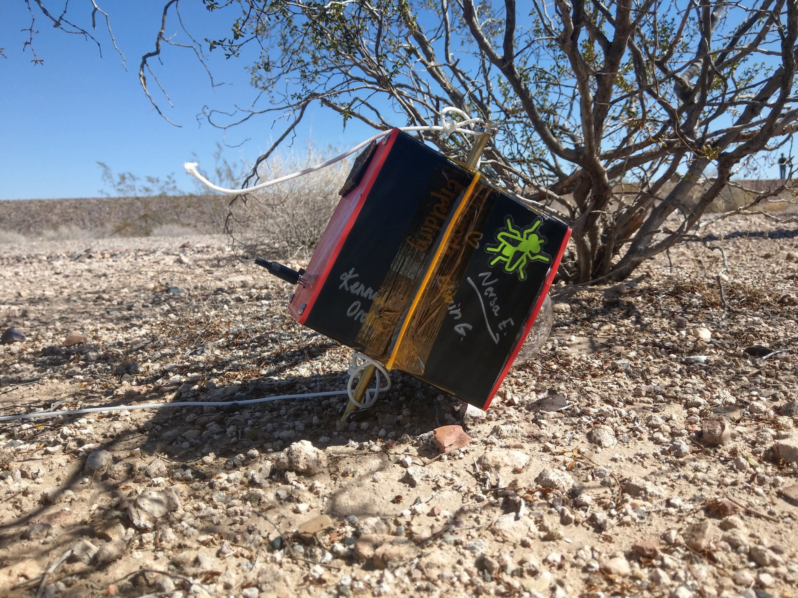
Introduction
Desired goals for Payload:
Make a 3D printed payload
Use satellite communication to receive live data
Gather sensor data as the payload ascends
Record burst of balloon and take 360° footage
Sound experiment

Slide 3
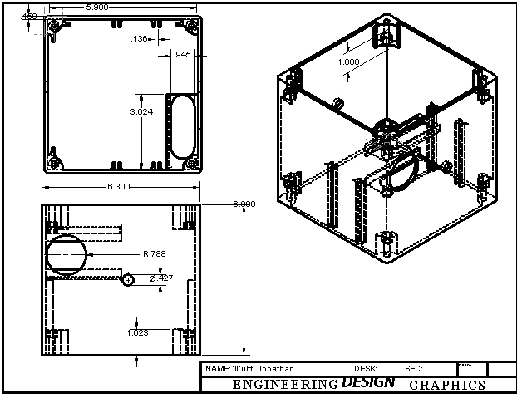
Payload Design
SolidWorks
Final features:
Screw holes
Lens holes
Doors
Slots for components

Slide 4
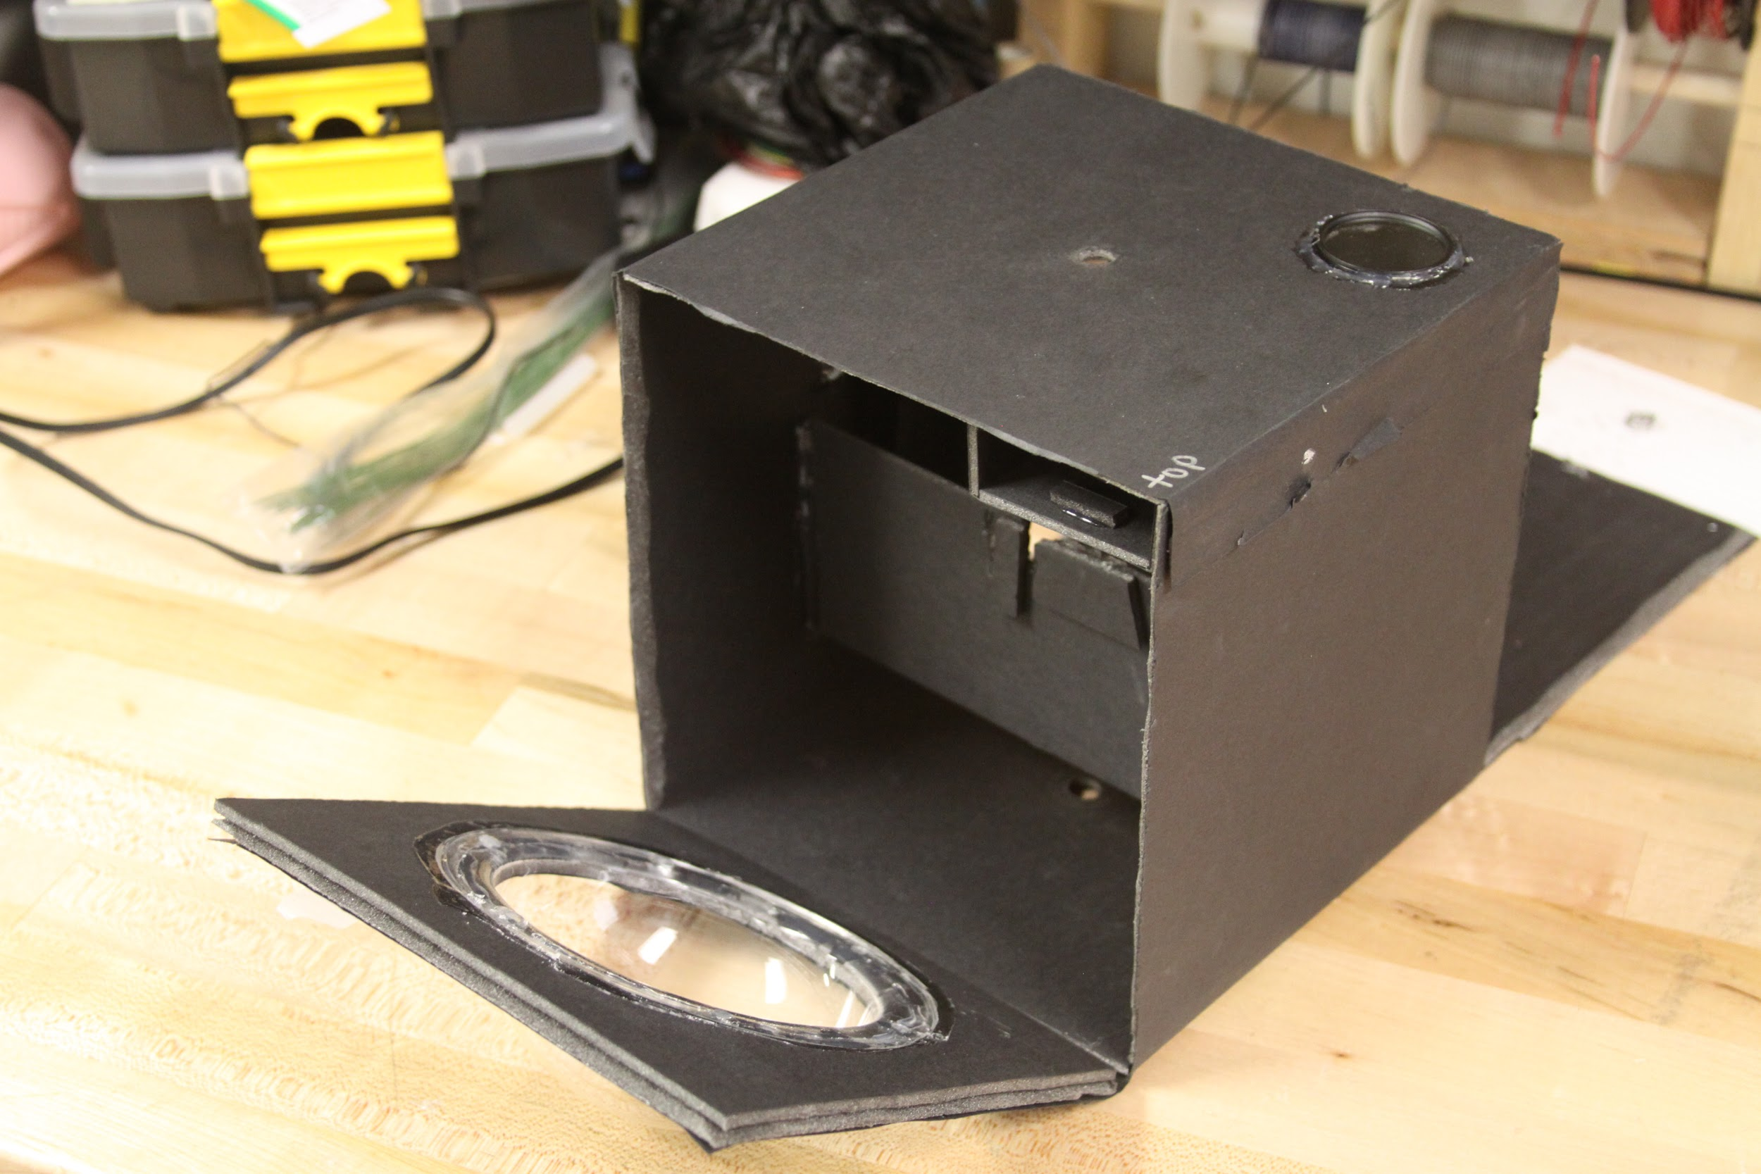
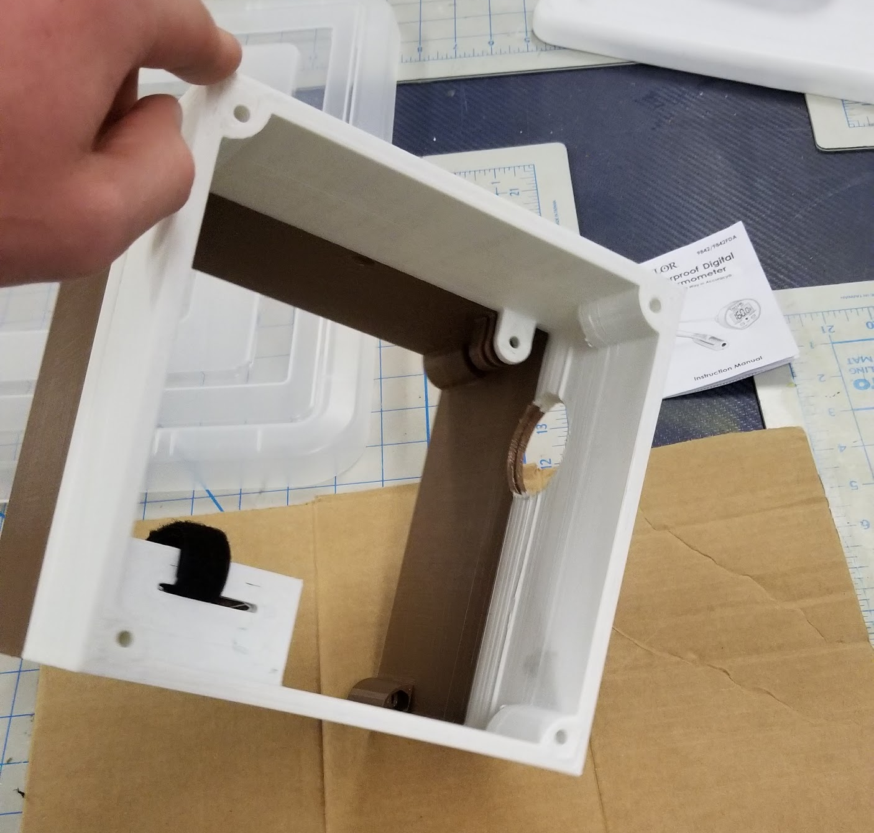
Prototypes
Number of prototypes
Mistakes
Lessons
Testing

Slide 5
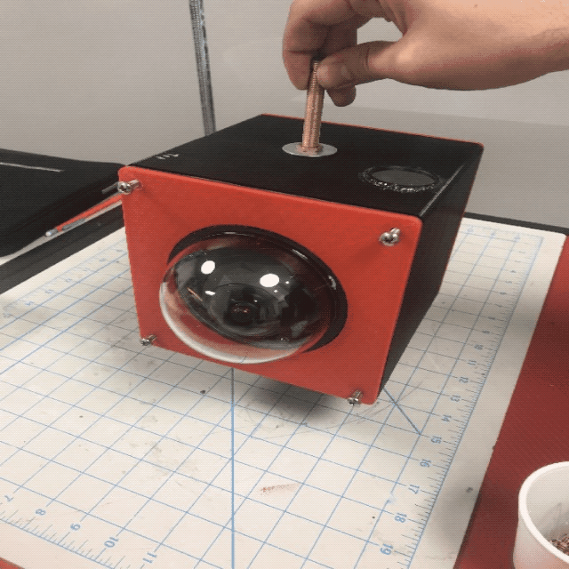
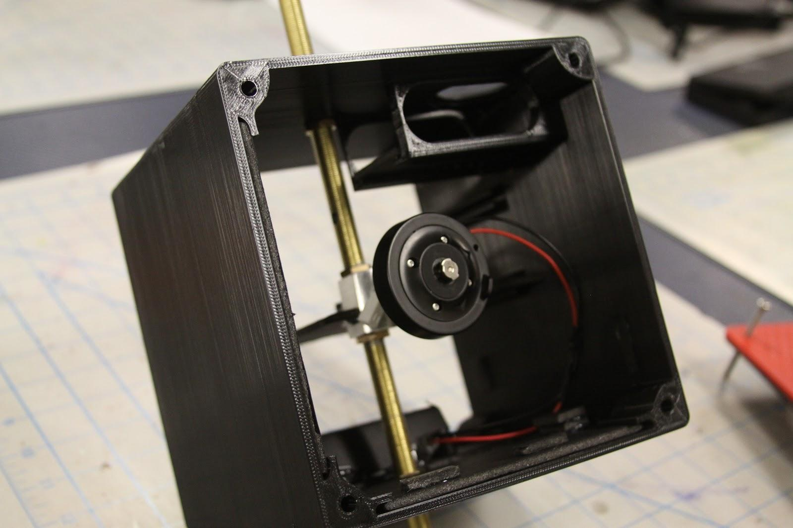
Payload Design:
3D printing

Slide 6
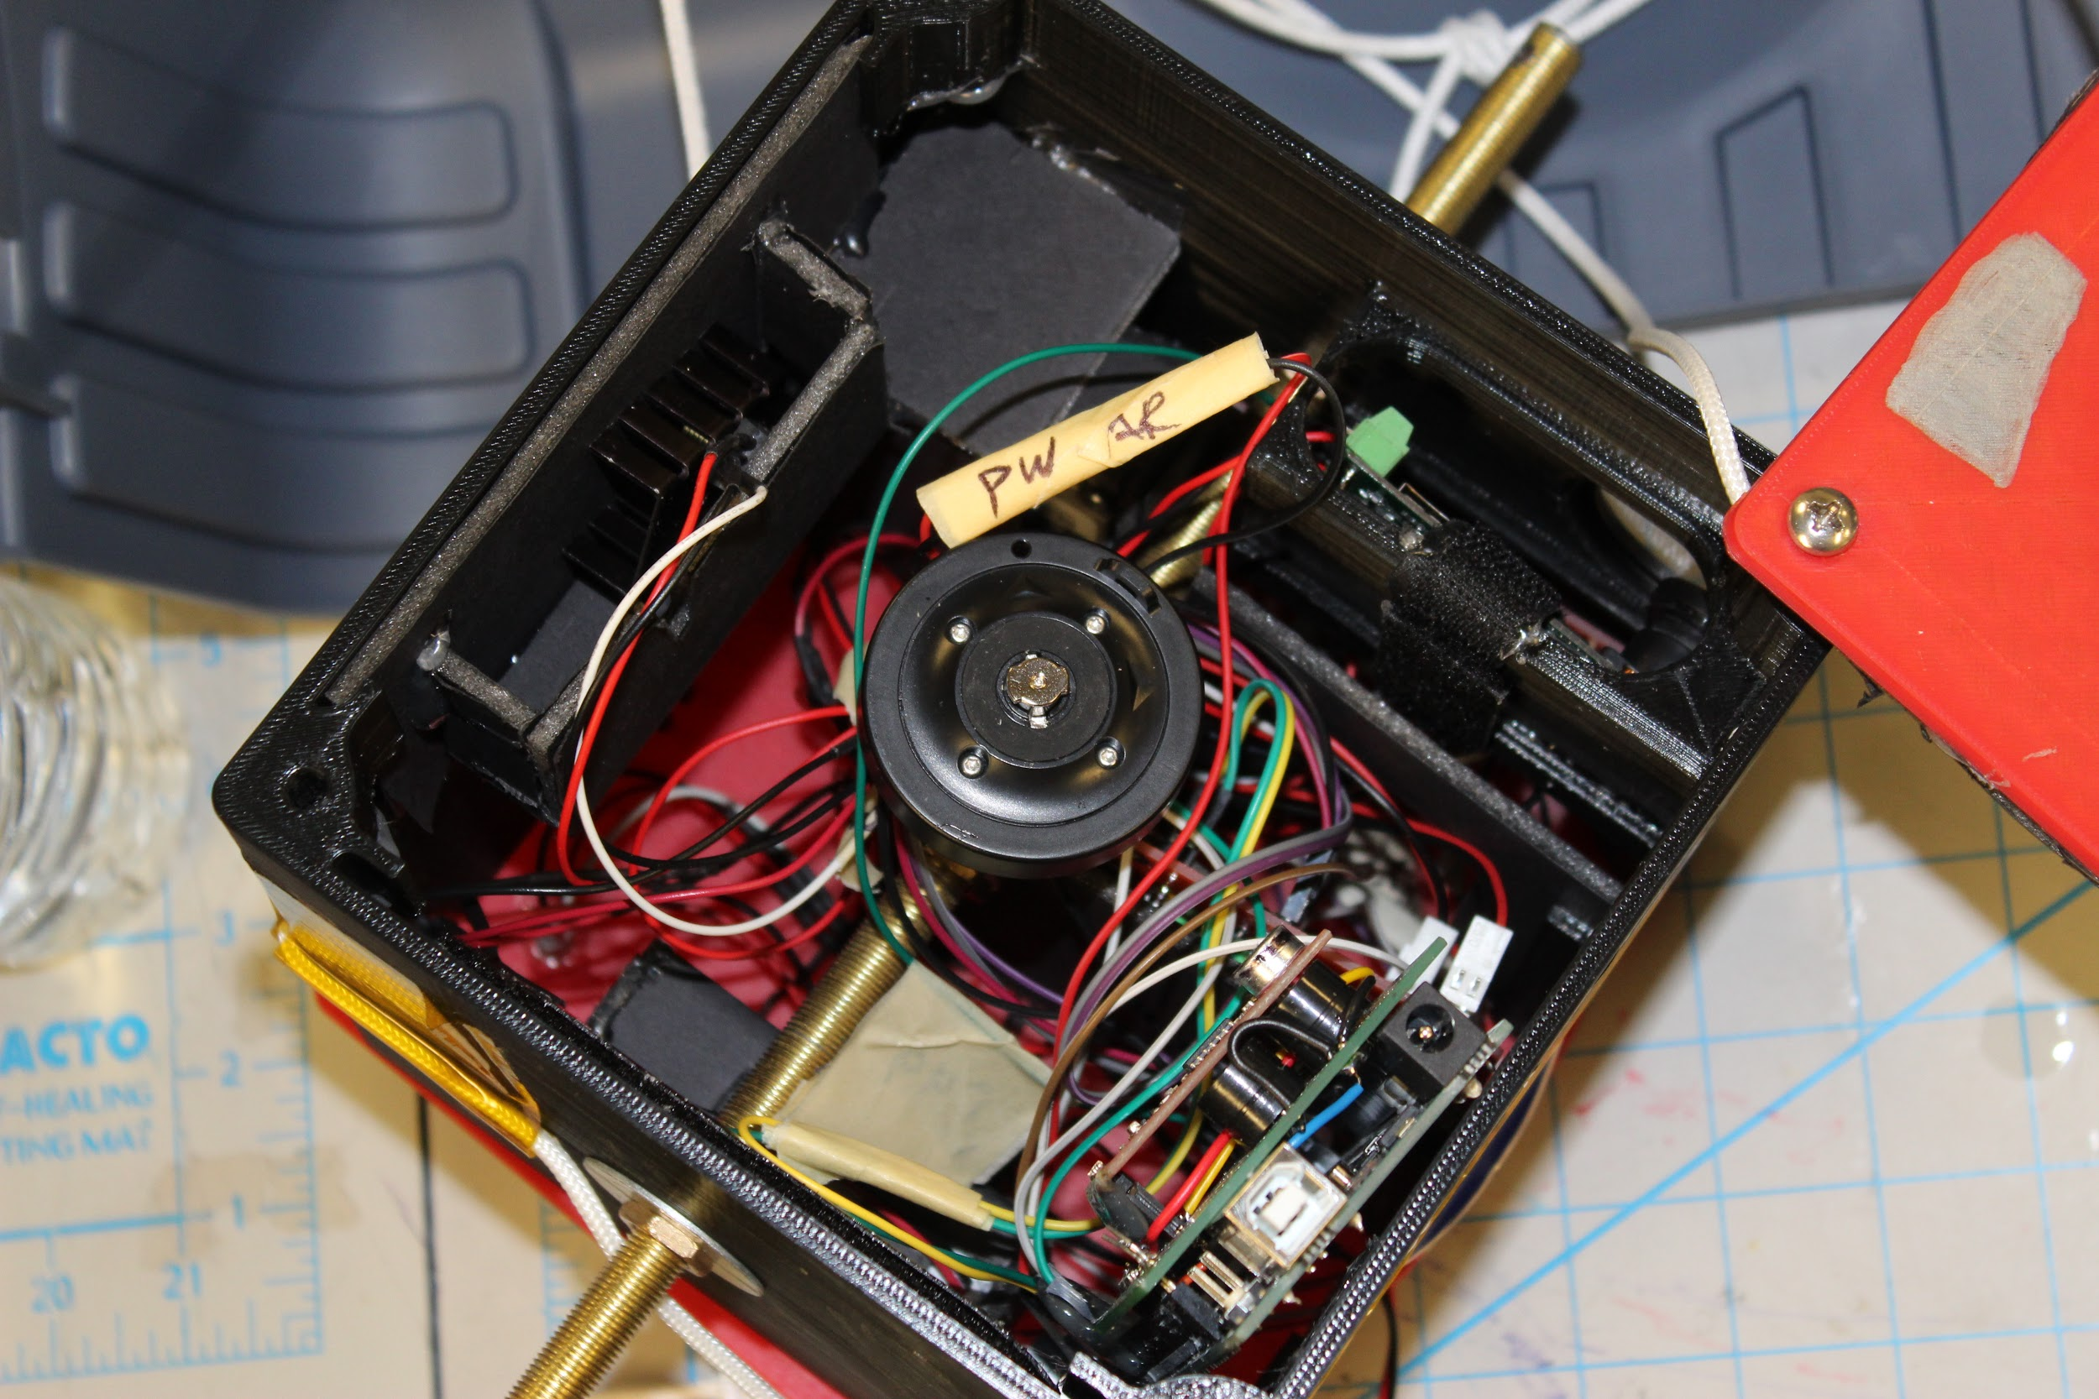
Payload Design:
Populating

Slide 7
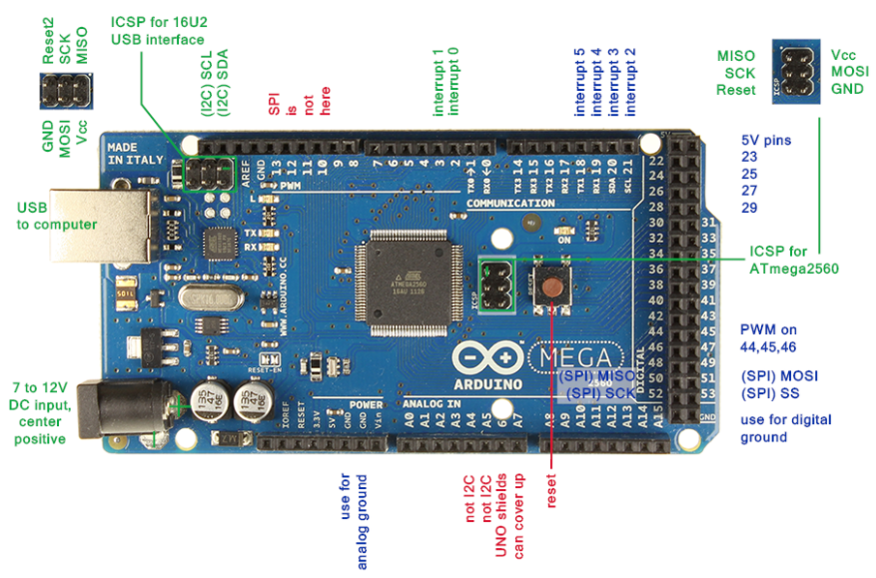
Microprocessor
Arduino MEGA 2560
ATmega2560 chip
54 digital I/O pins , 16 analog inputs
Compact and Lightweight
4 (universal asynchronous receiver-transmitter) UARTs
C/C++ languages

Slide 8
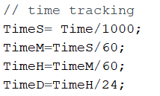
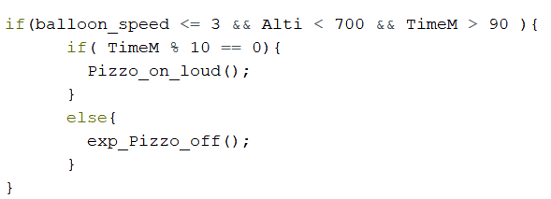

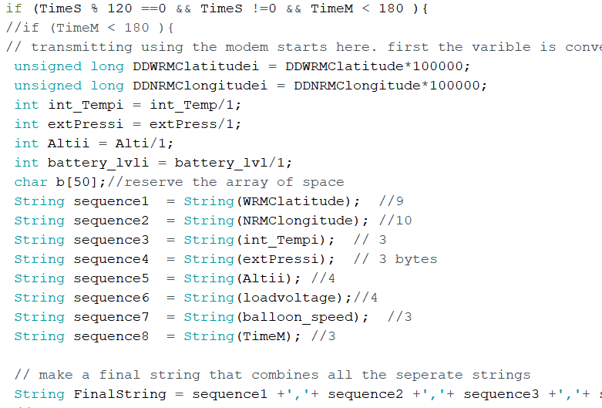
Coding
Arduino programmed to collect, store, and process data
Sent control signals to Hack HD Camera to turn on and begin recording
Data collected was stored on a microSD card
Data also transmitted every two minutes via a ROCKBLOCK modem
Data was received during the flight through email and was accessible around the world

Slide 9
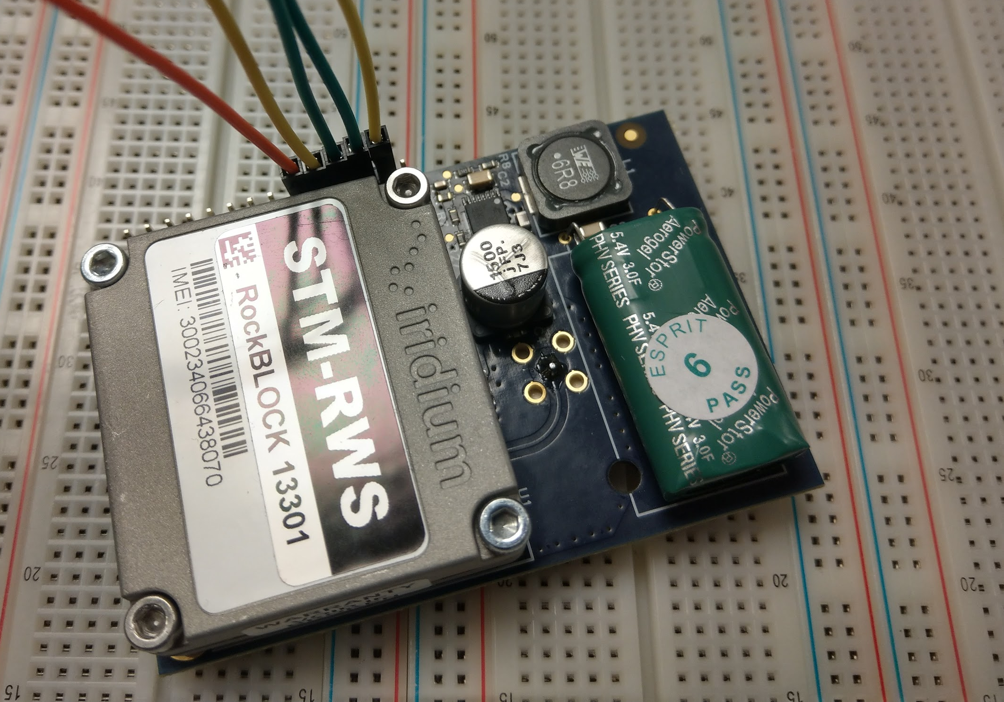
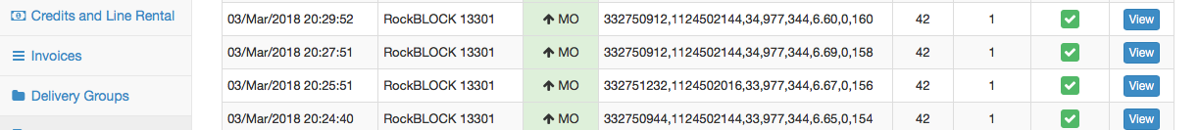
RockBLOCK Device:
Iridium Satellite Communication
HAM Radio vs. GCC
No license required
Cost of RockBlock: $250
10 cents for up to 50 bytes
$14 per active month
Supercapacitor
Ability to receive live data from our sensors, battery, and GPS
Arduino software designed to keep each data transmission under 50 bytes
RockBlock was controlled by Arduino, which attempted to send data every 2 minutes

Slide 10
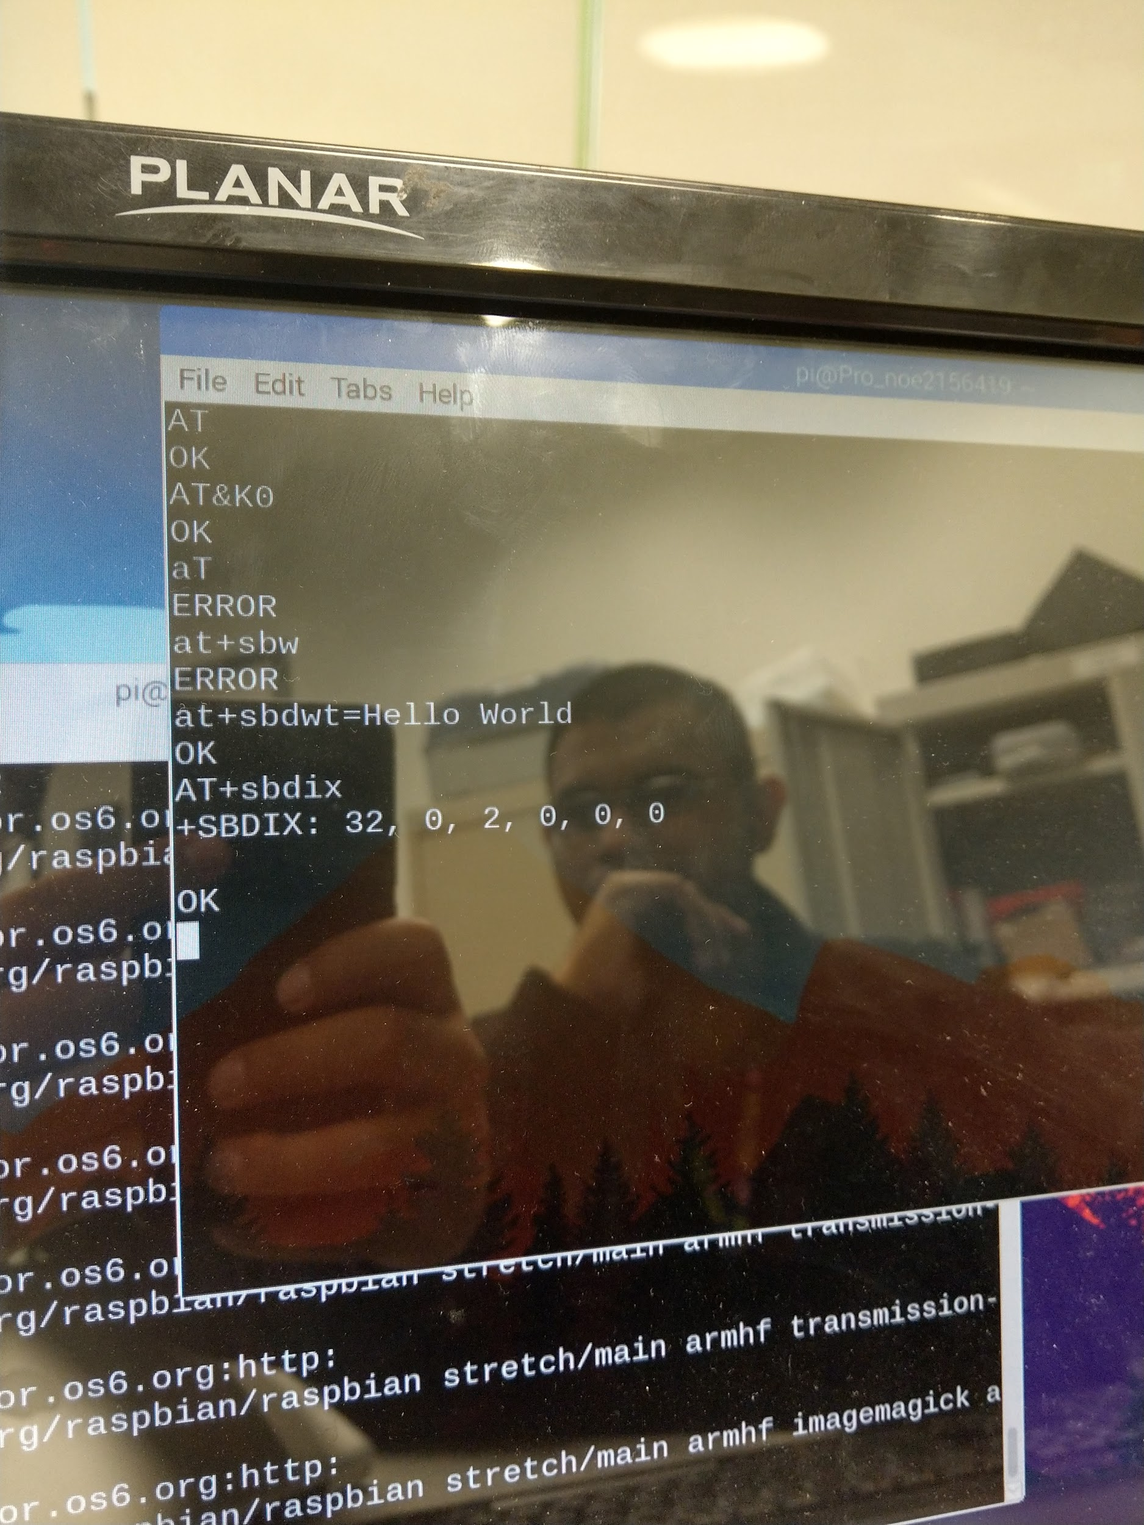
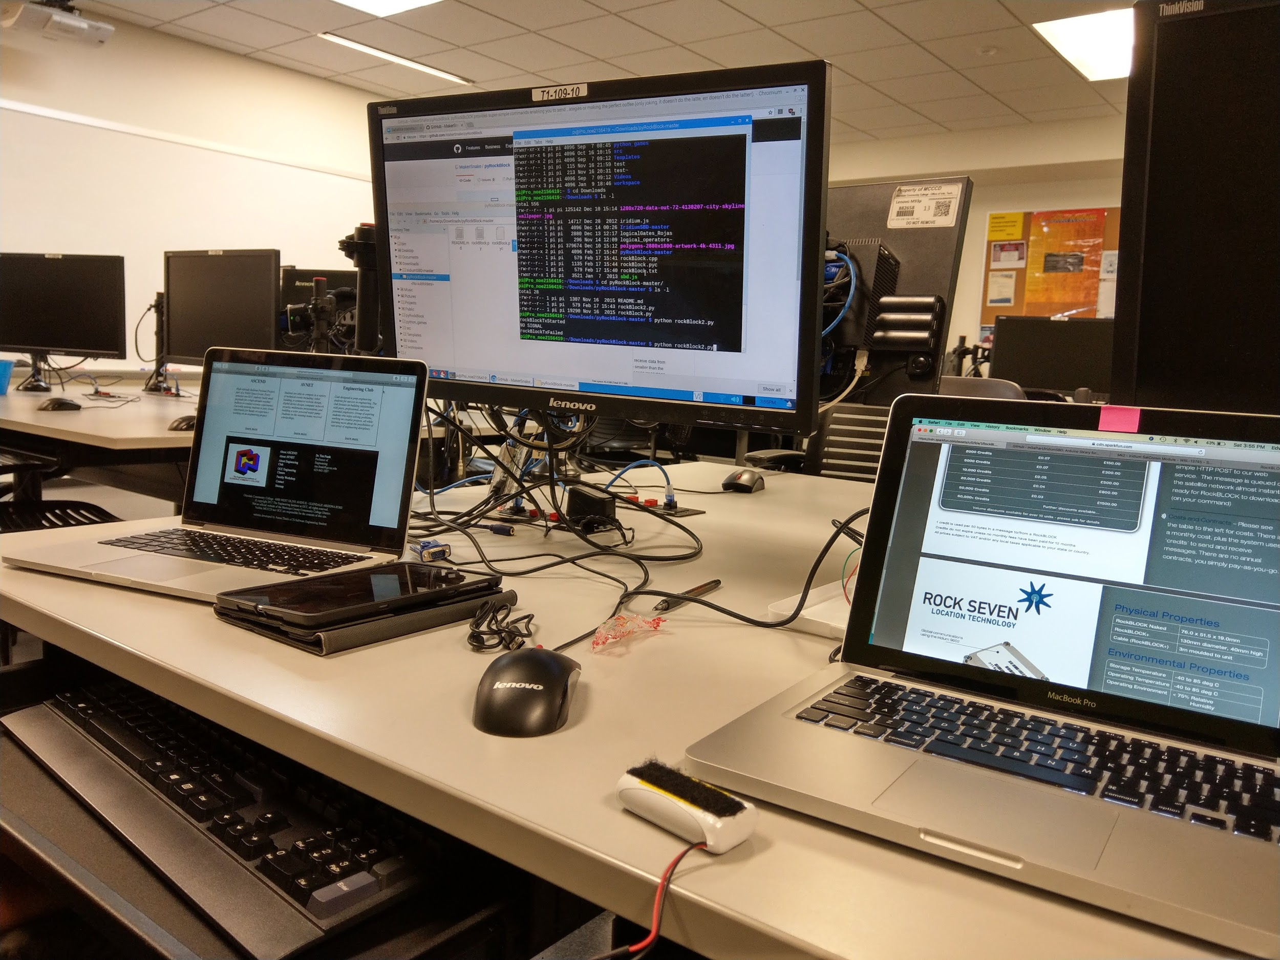
RockBLOCK Device:

Slide 11
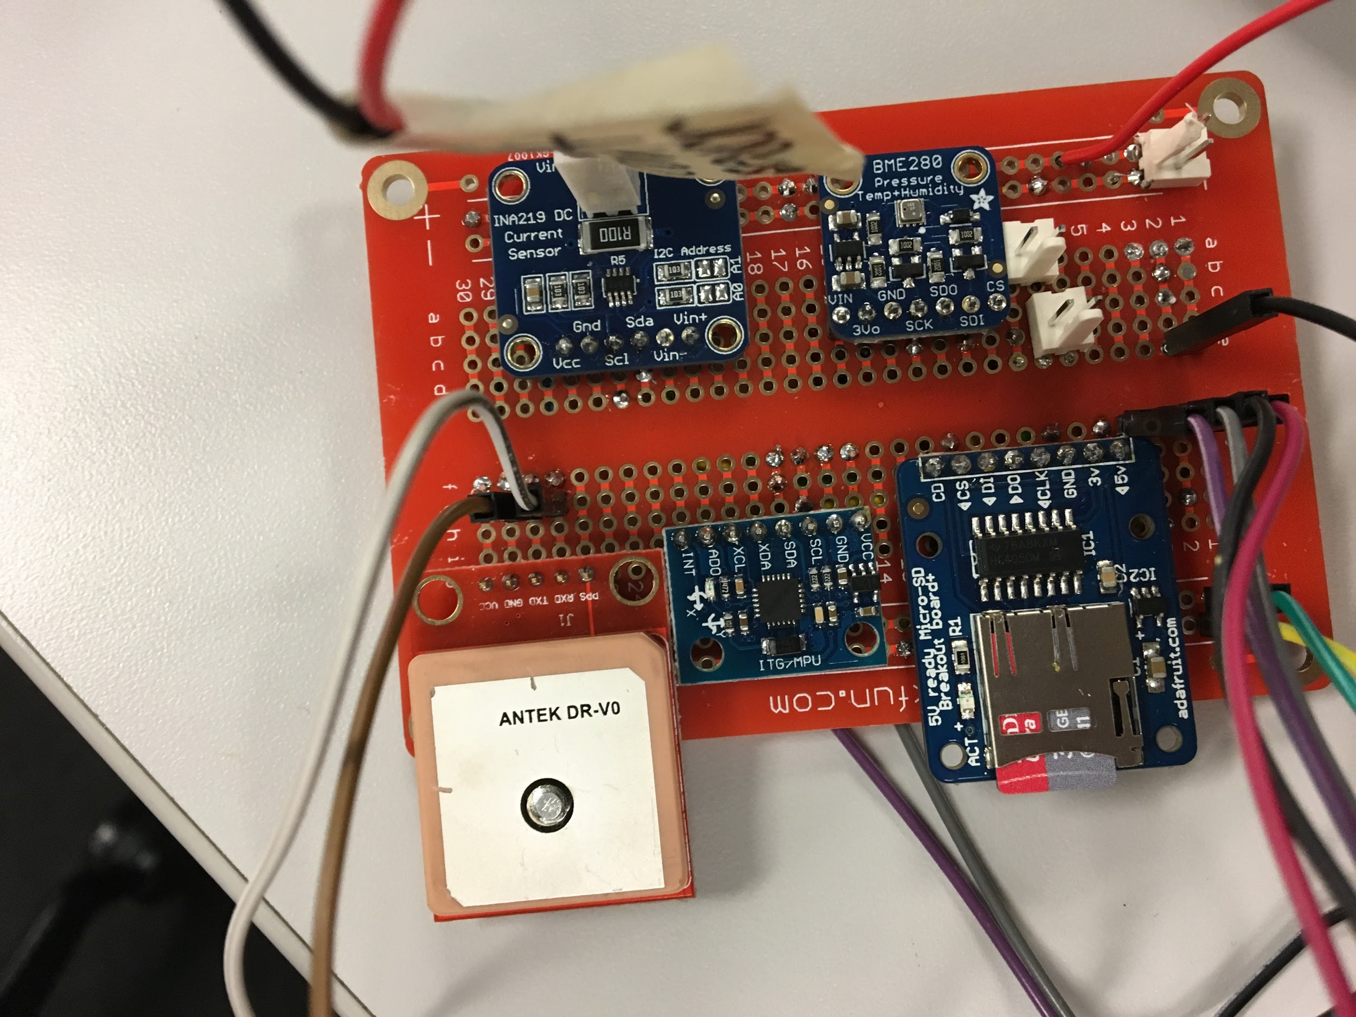
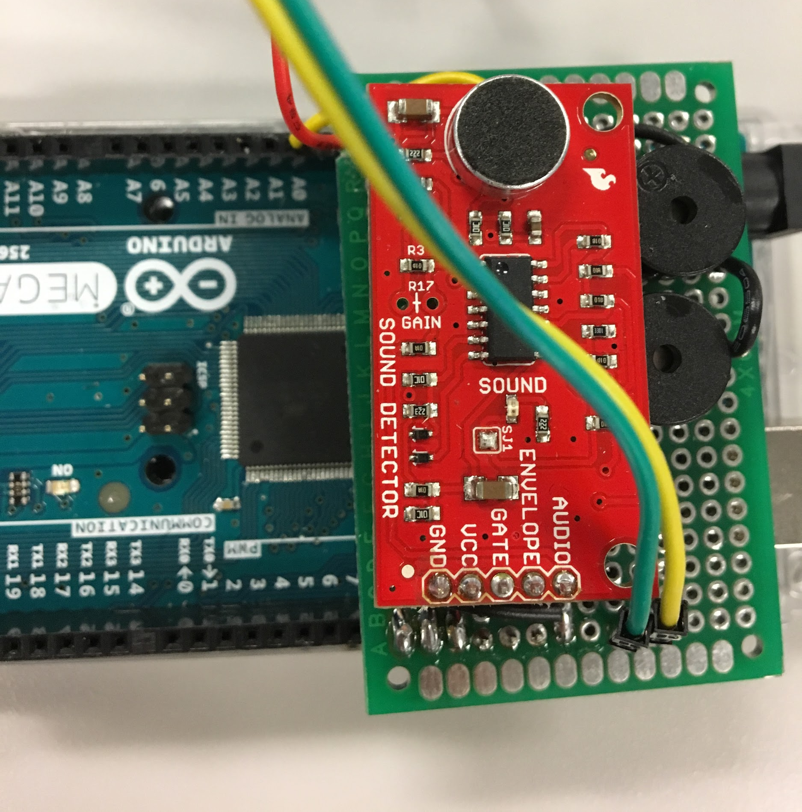
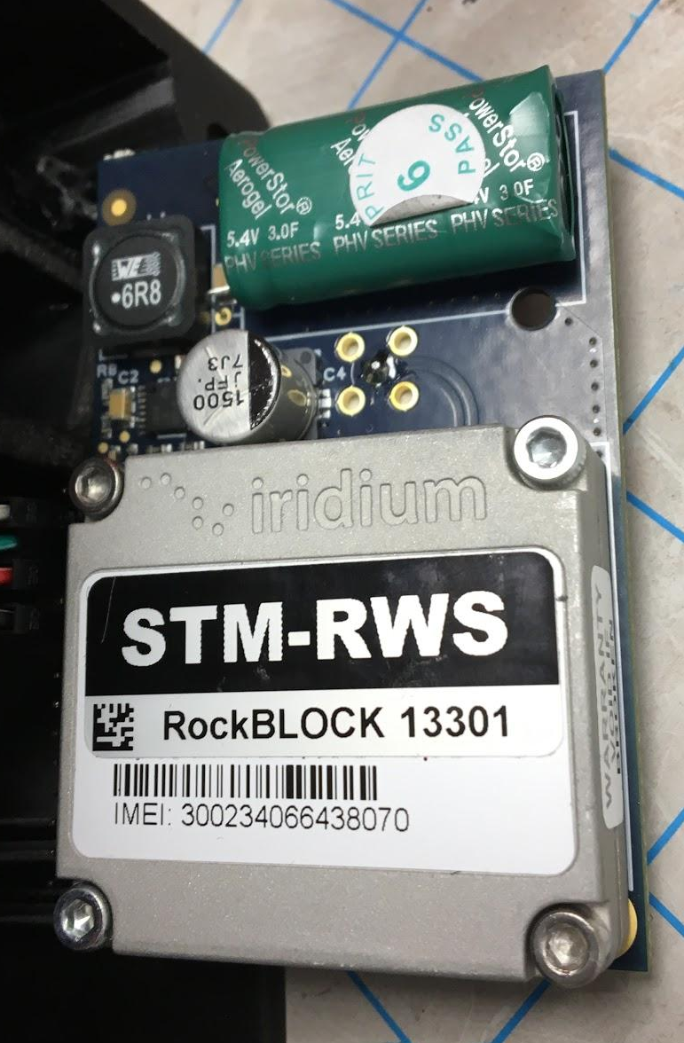
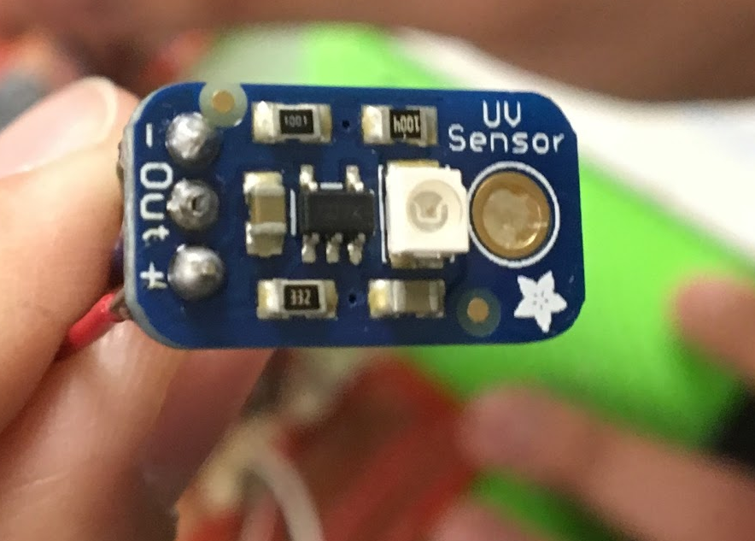
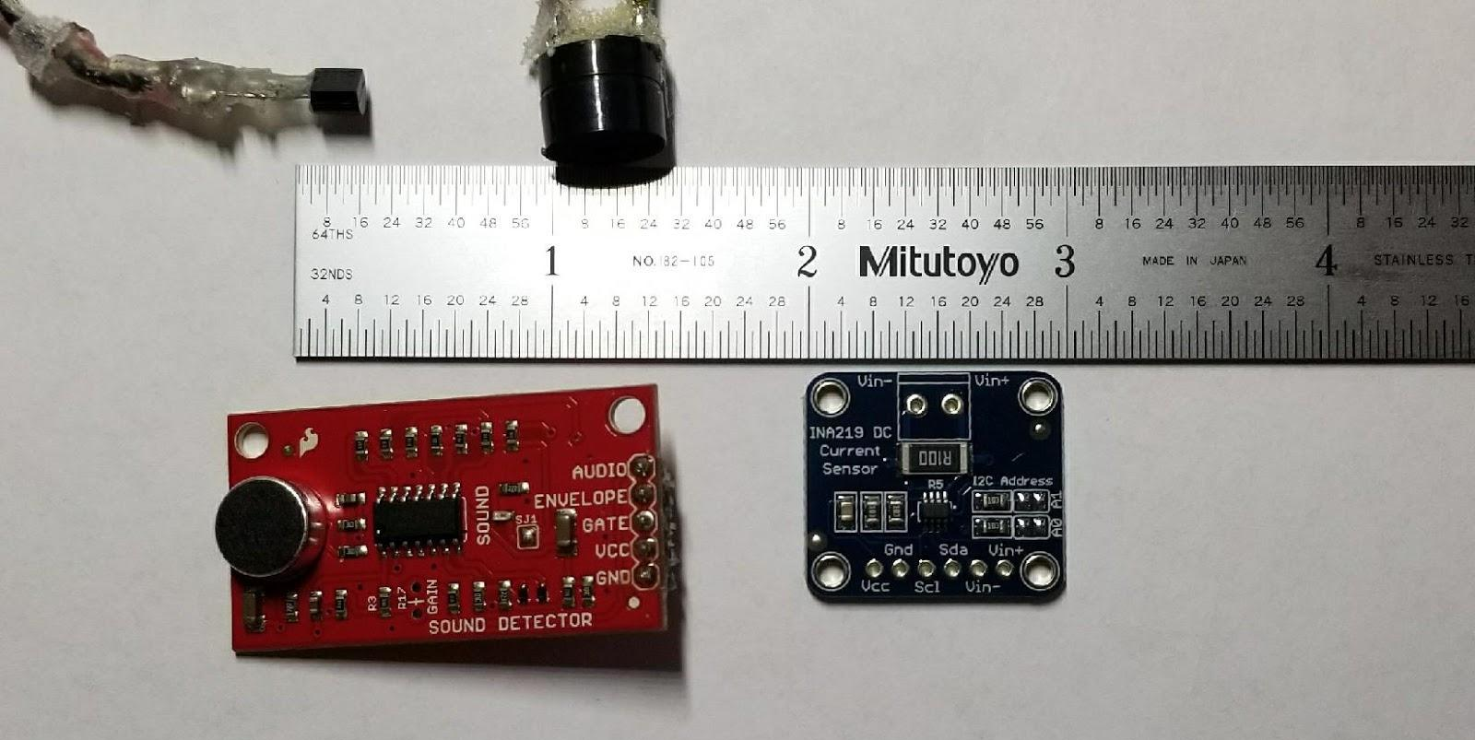
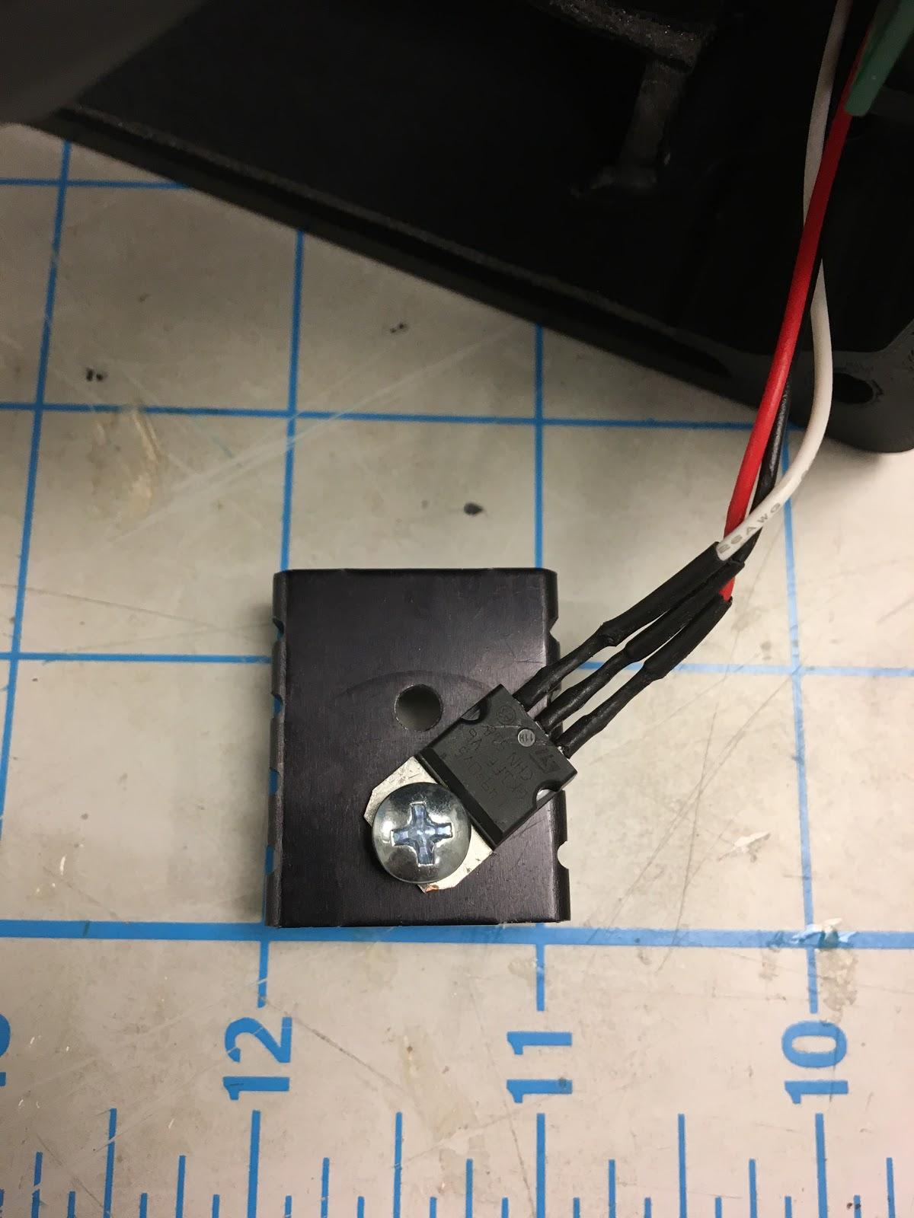
Components of Payload

Slide 12
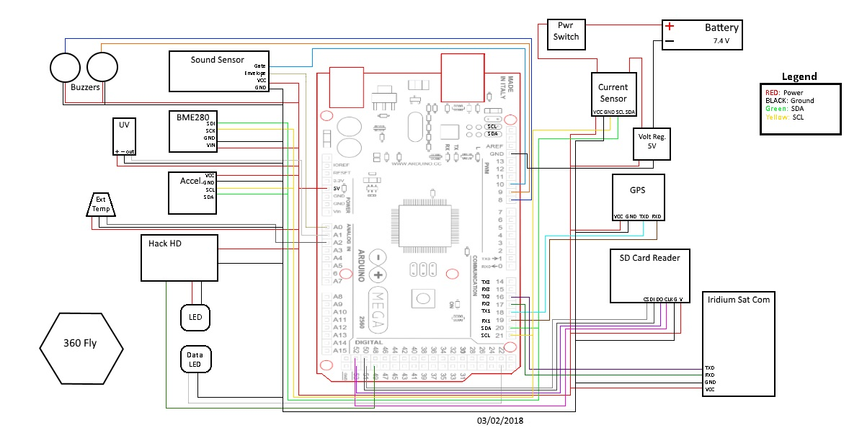
System Block Diagram

Slide 13
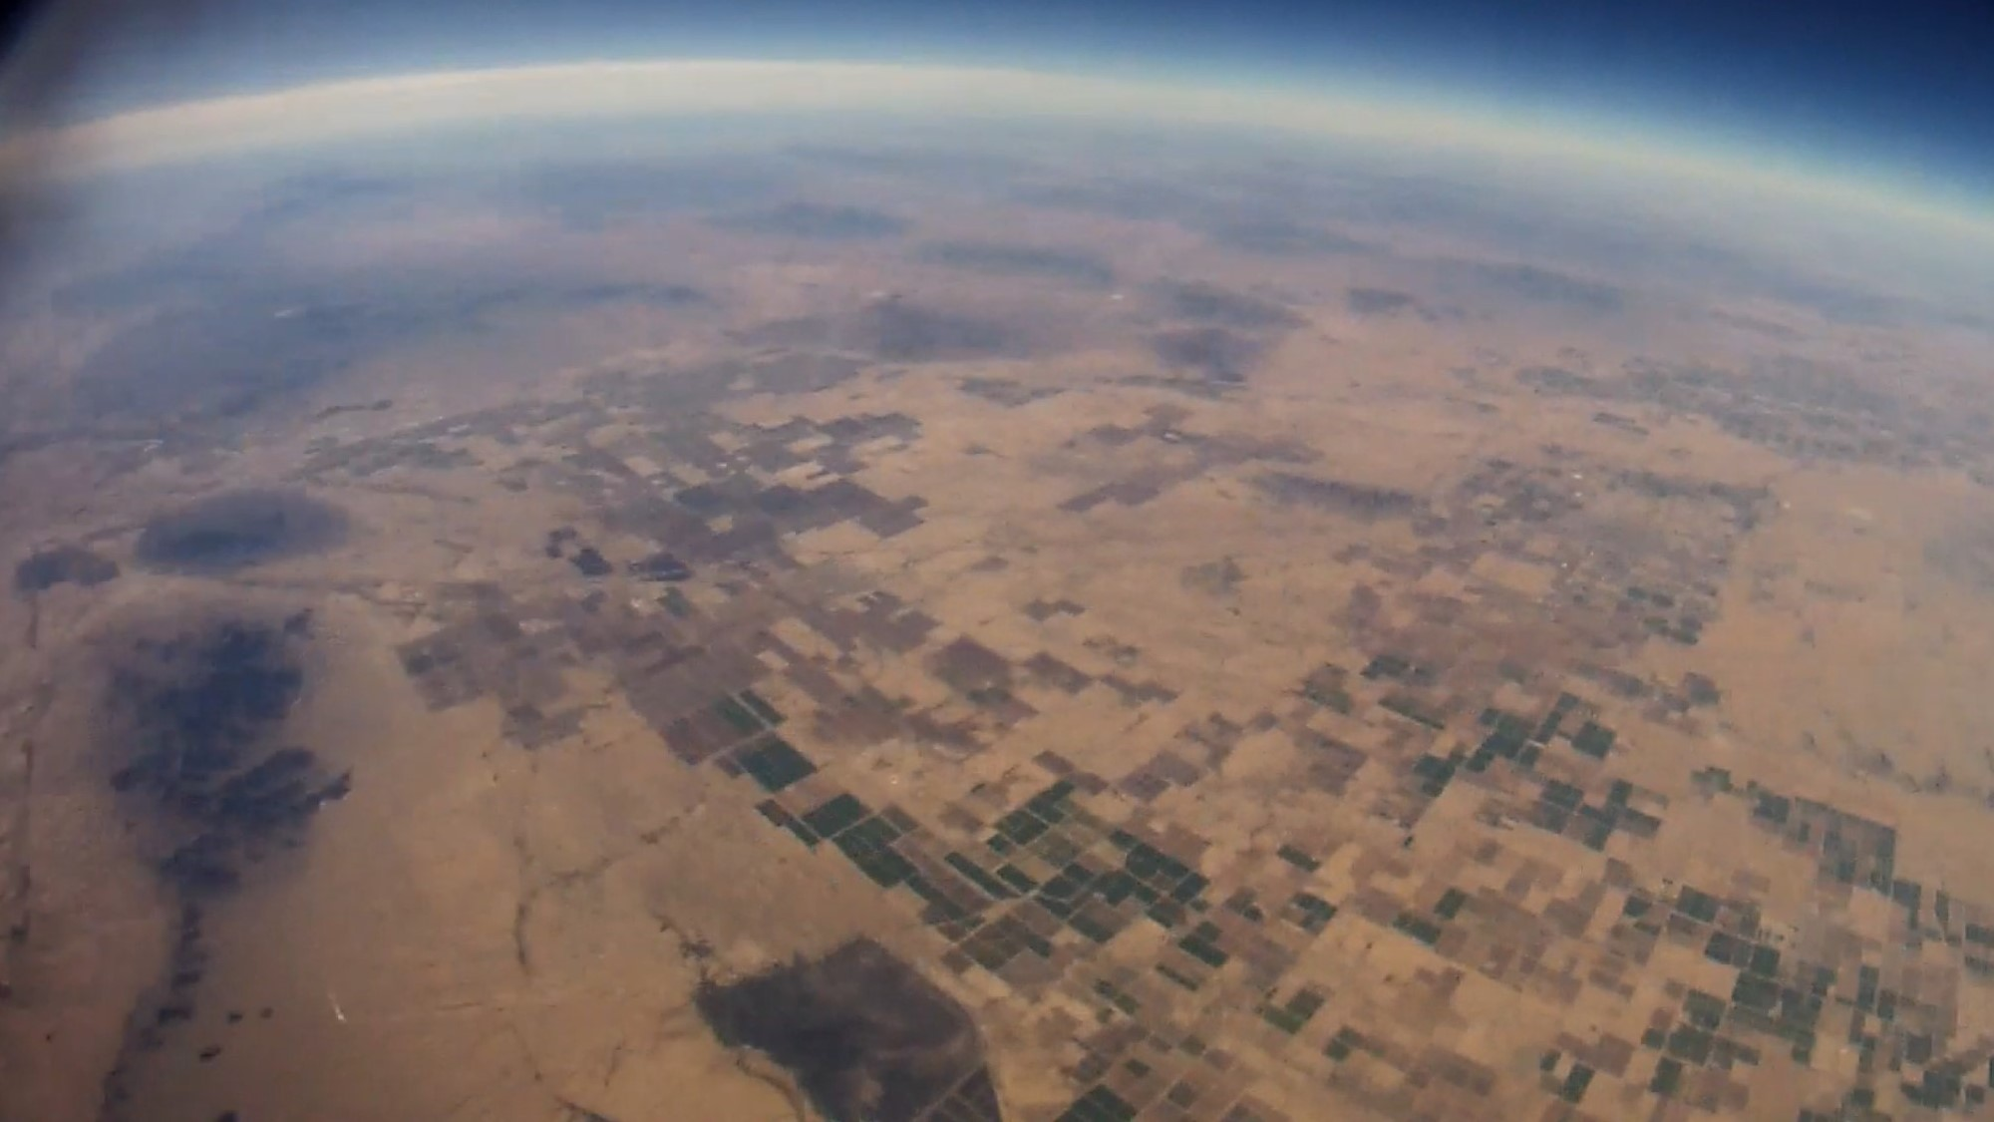
Camera Objectives
Goals for payload Cameras:
Monitor balloon’s expansion and capturing the burst.
Hack HD camera was used to meet this objective.
Record 360° panoramic view from the balloon payload.
360fly camera was used to meet this objective.

Slide 14
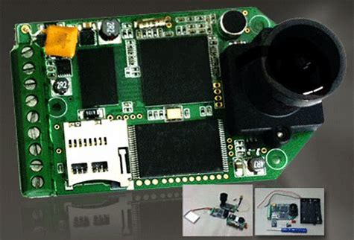
Hack-HD
Resolution: 1080p HD
Frame Rate: 30 FPS (Frames per Second)
Storage: External microSD Card
Controlled via Arduino

Slide 15
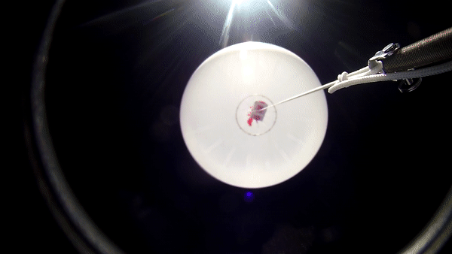

Slide 16
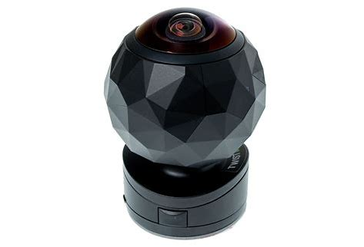
360fly
Weight: 142 g
Resolution: 1504*1504 pixels
Recording Rate: 20 Mbps
Powersource: 1630 mAh Li-polymer Battery
Record time: 2 hr with 14 hr standby
Cost: $115

Slide 17
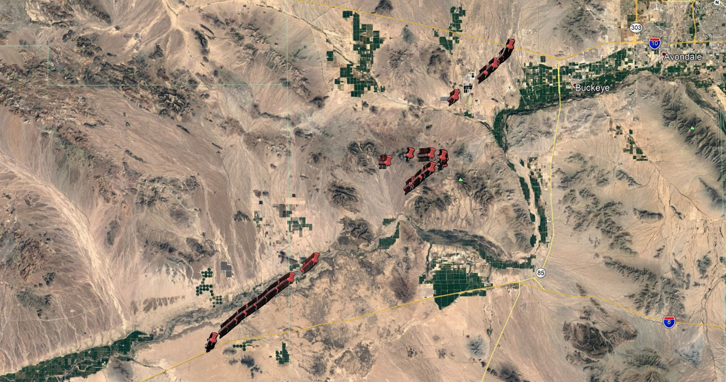
GPS
GCC Coordinates

Slide 18
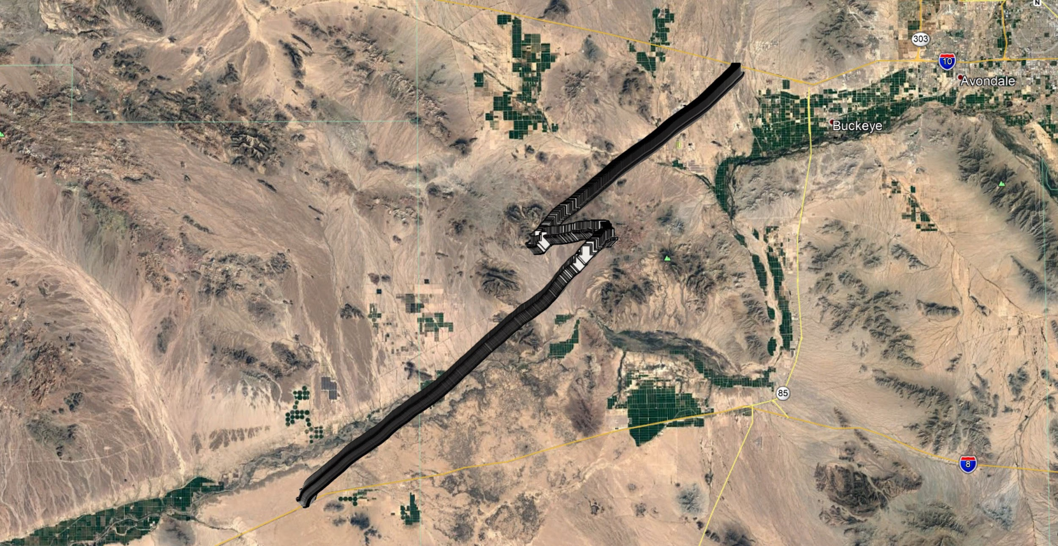
GPS
ANSR Coordinates

Slide 19
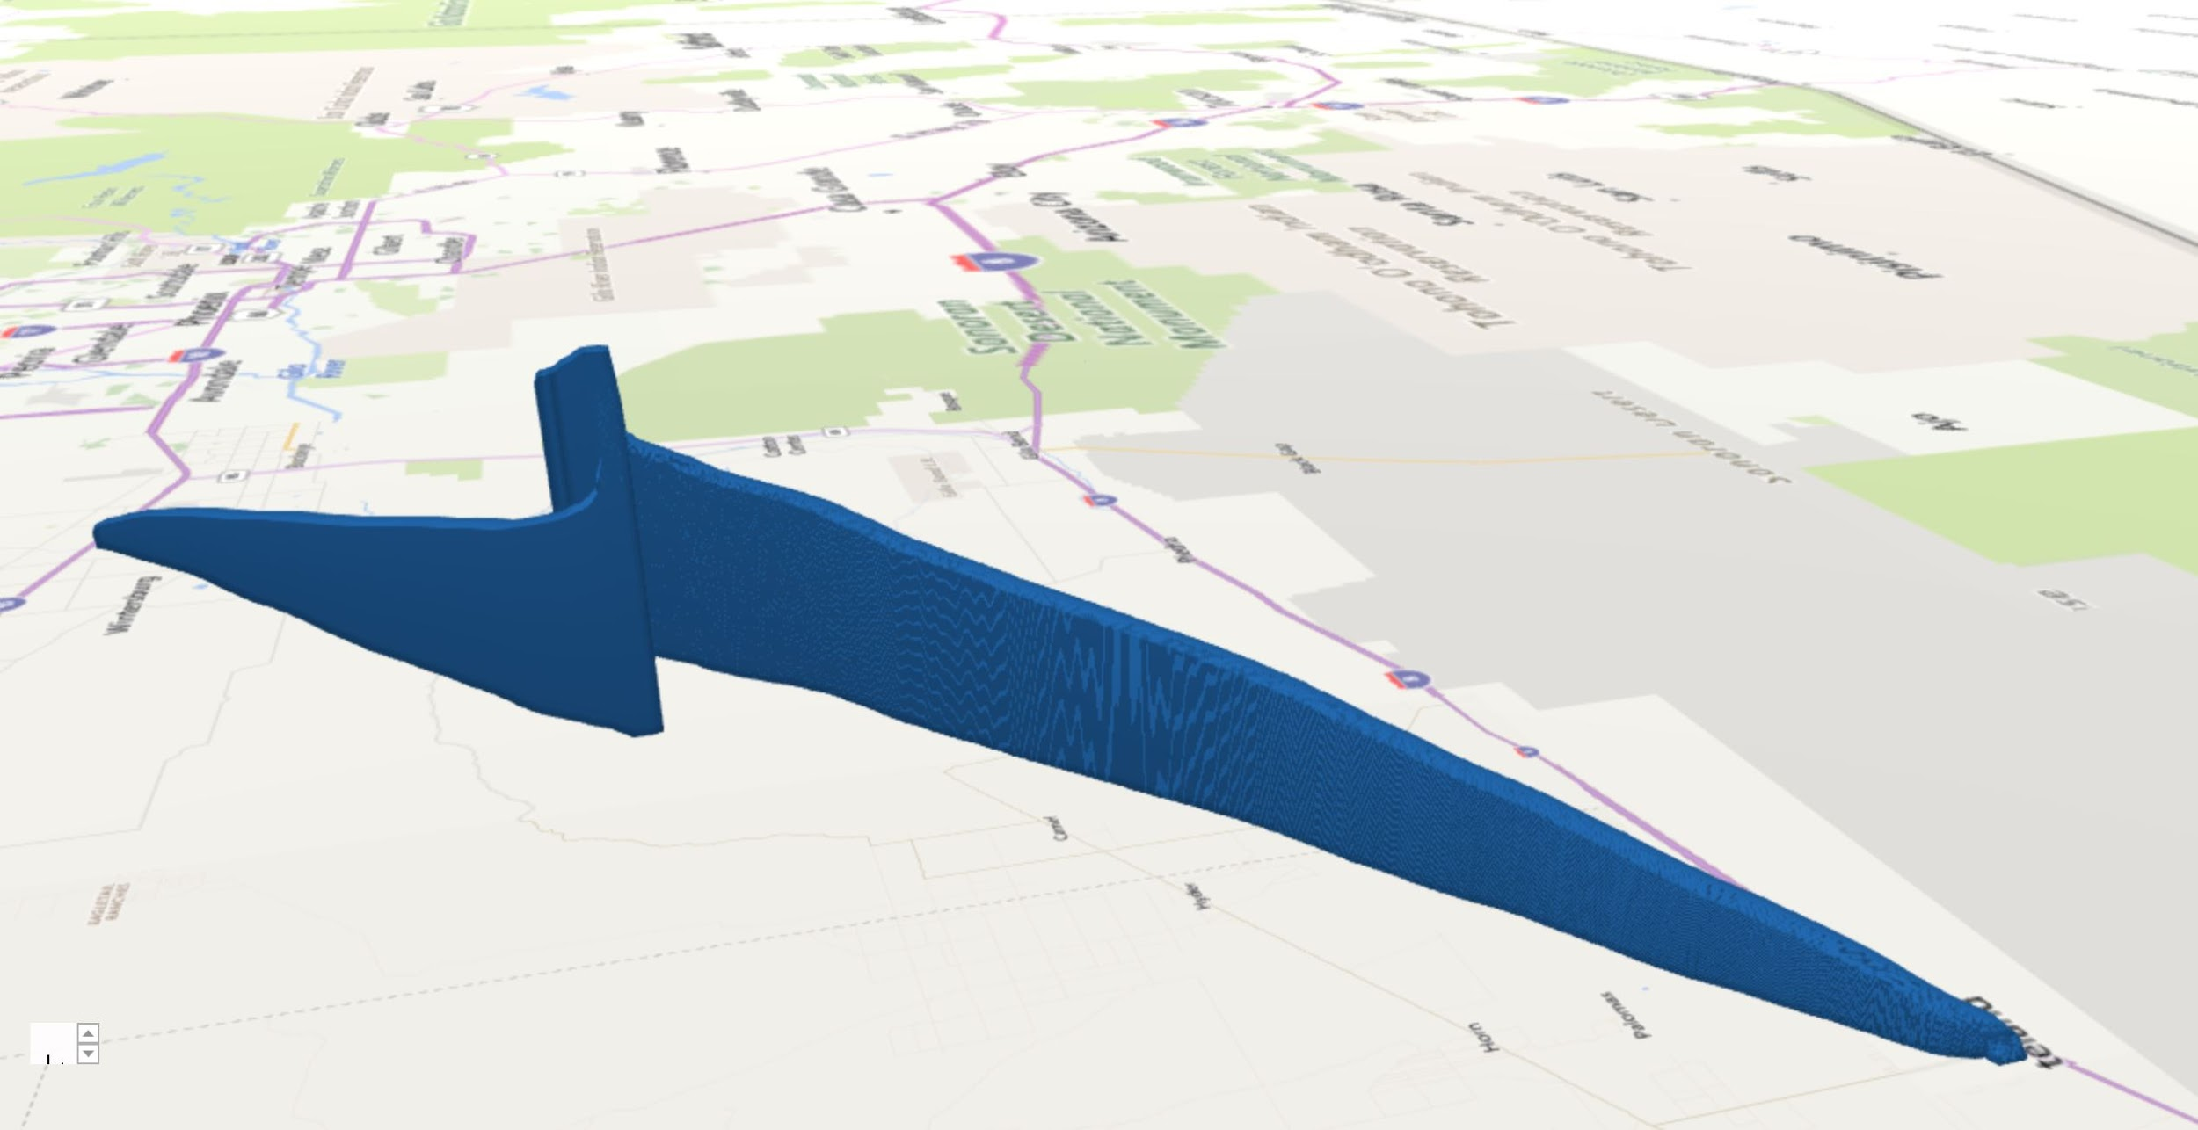
Altitude
ANSR Coordinates

Slide 20
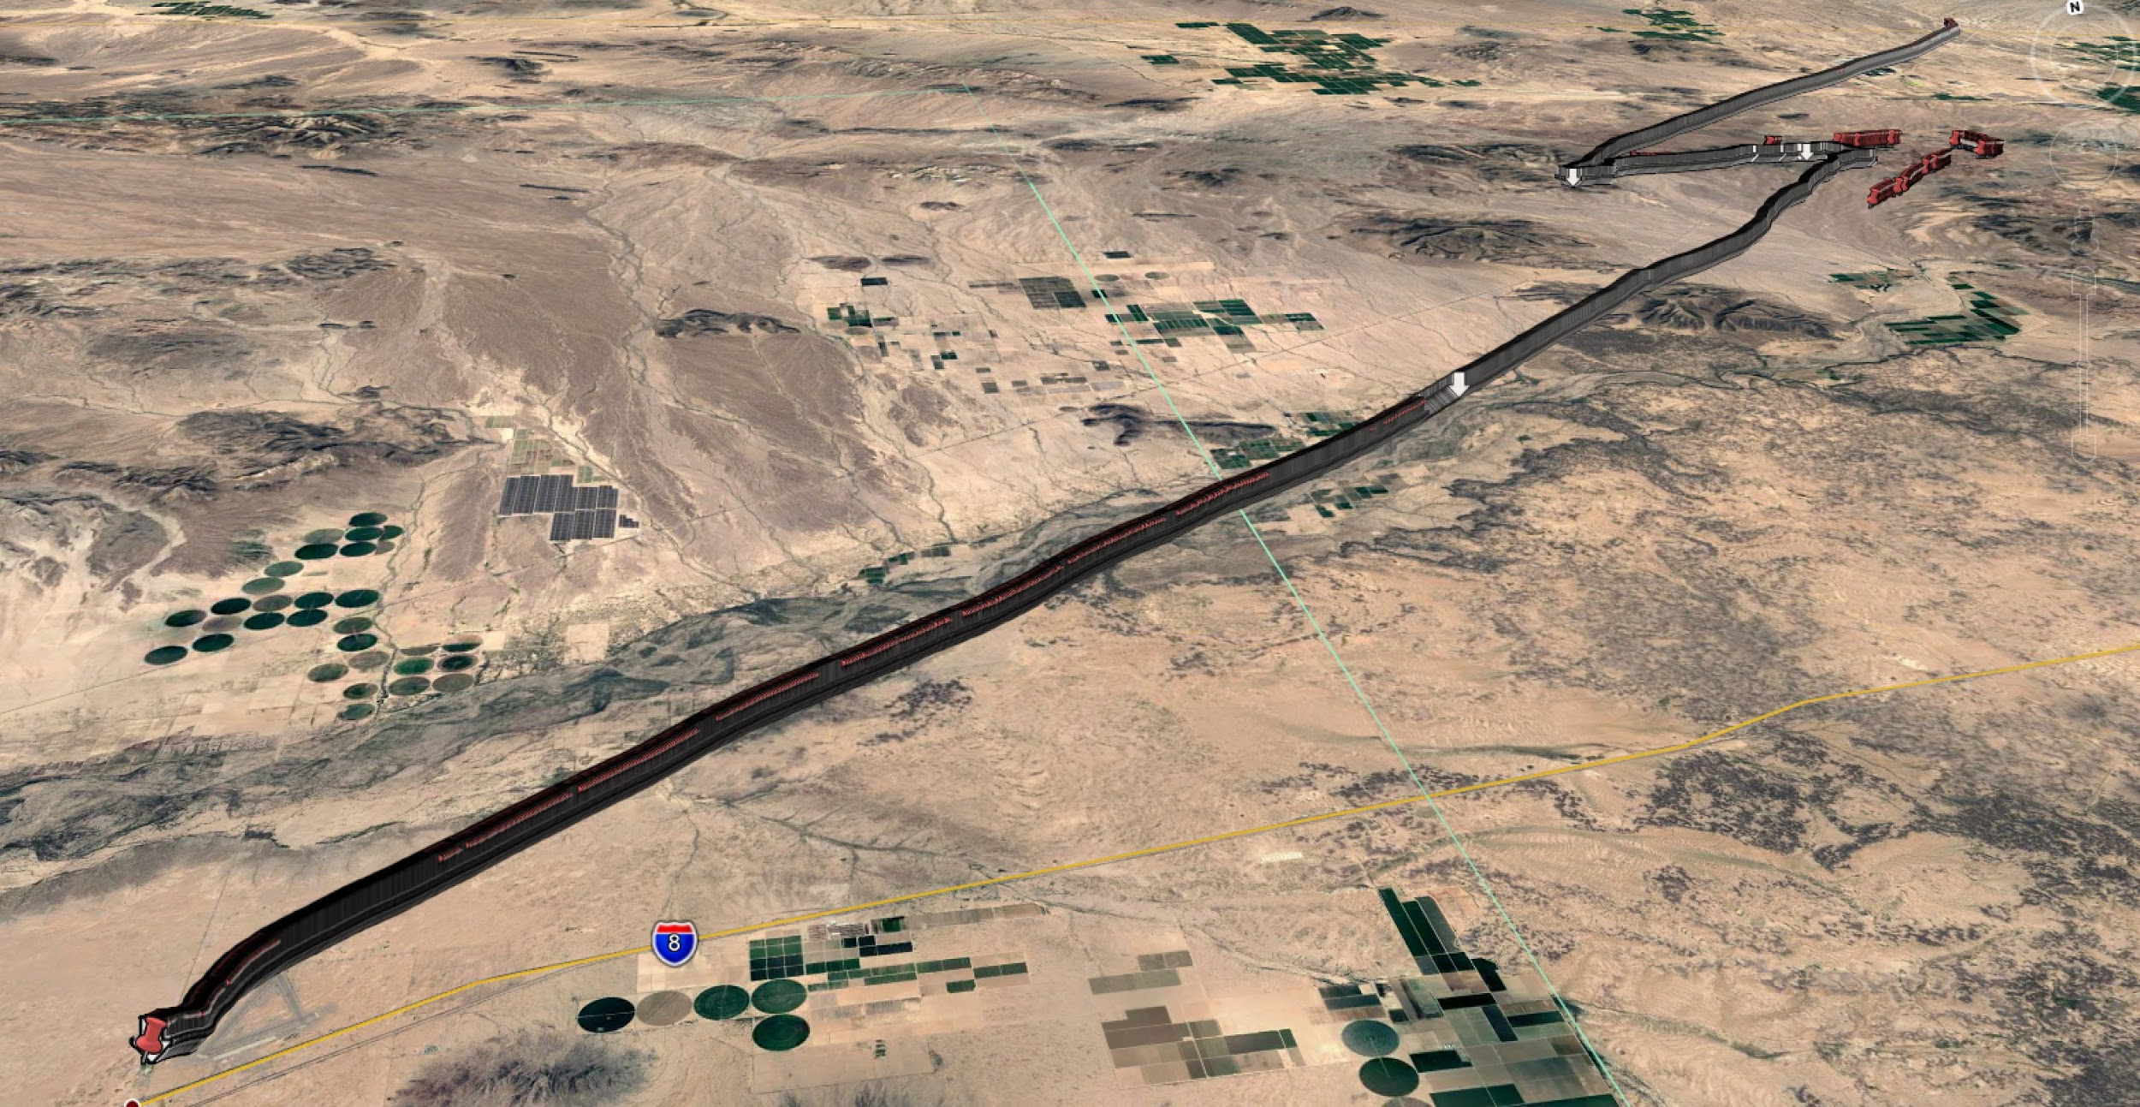
GPS
Combined Coordinates

Slide 21
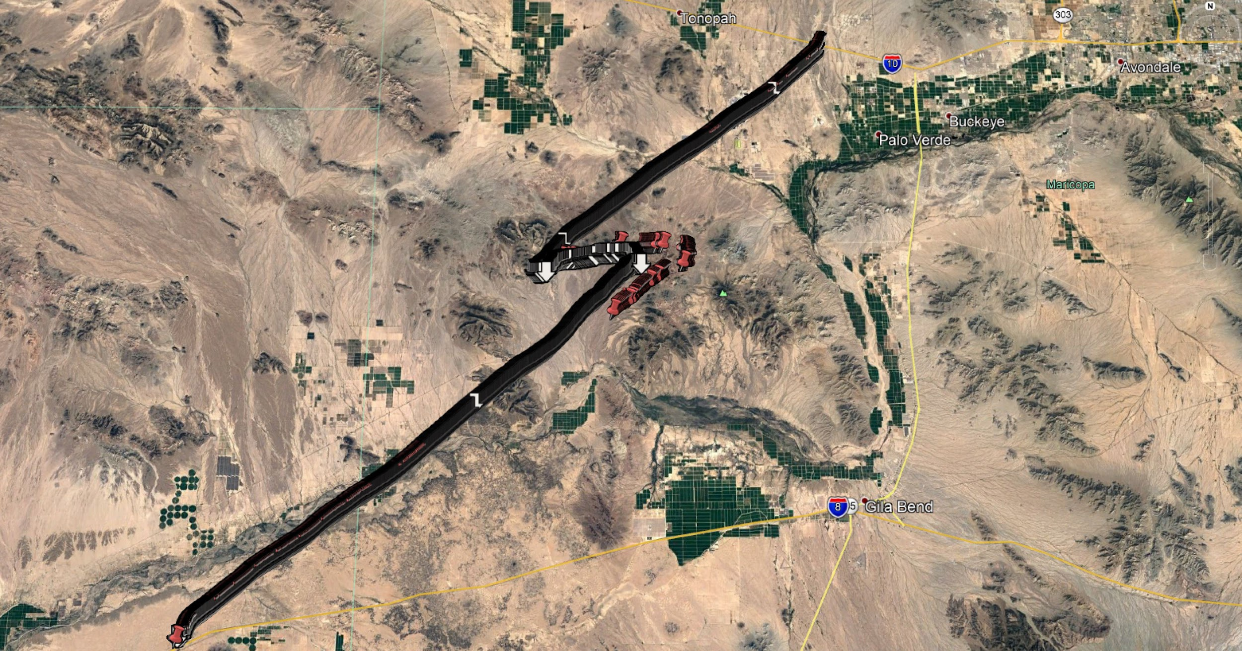
GPS
Combined Coordinates: Top View

Slide 22
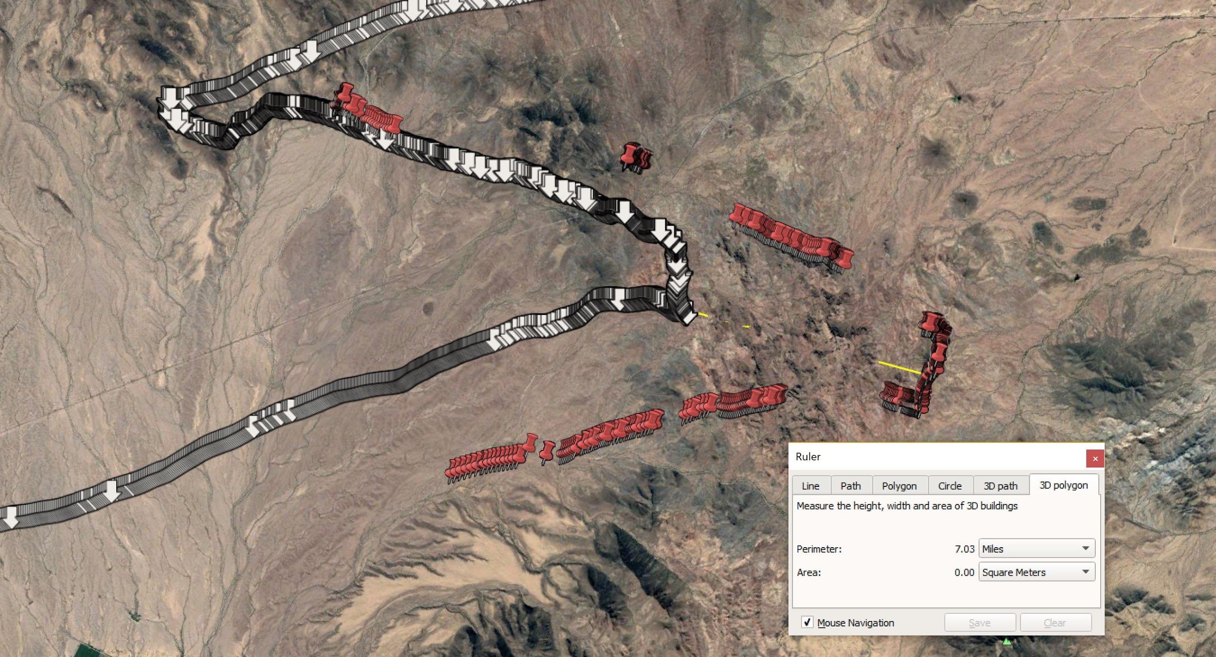
GPS: Error
Distance Apart

Slide 23
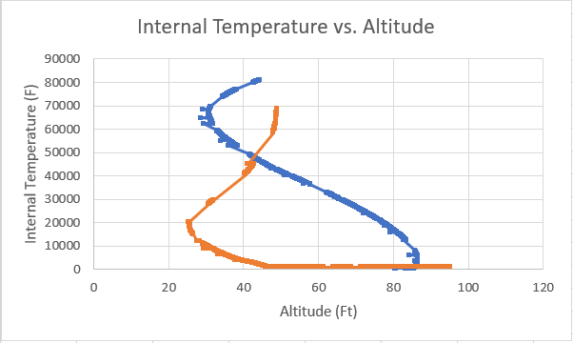
Internal Temperature

Slide 24
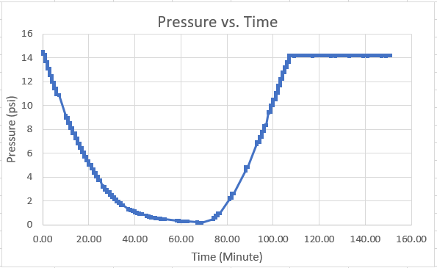
Internal Pressure

Slide 25
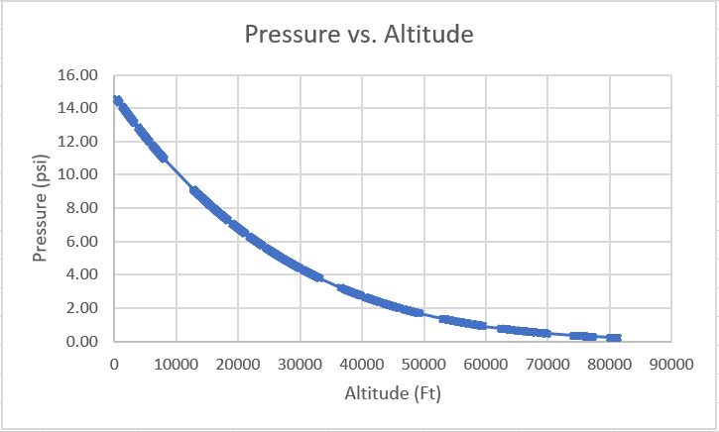
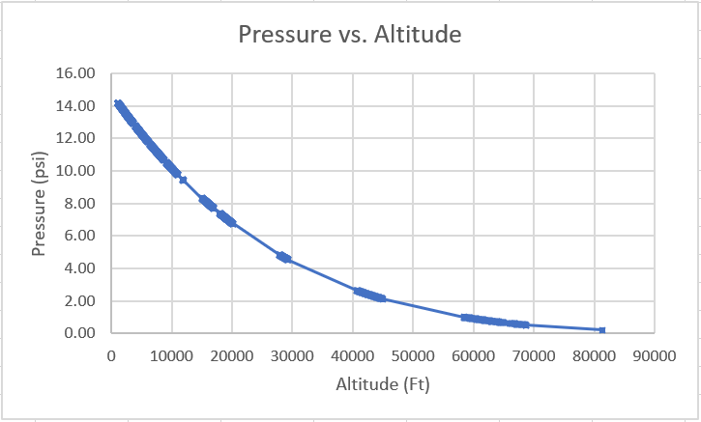
Internal Pressure
Launch to Burst
(Ascending)
Burst to Landing
(Descending)

Slide 26
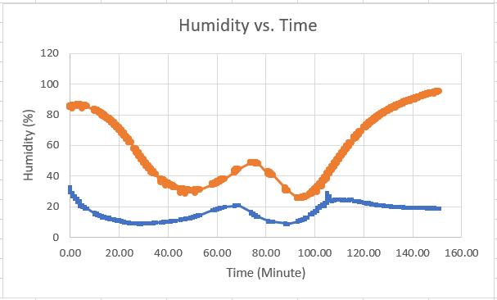
Humidity
Internal Temp vs. Time
Notes:
Describe why humidity is so high when it is around 80,000ft
Look into seeing how the sensor works

Slide 27
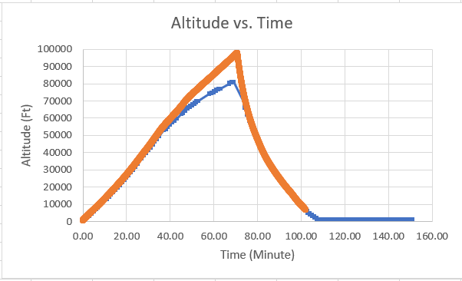
Altitude
Notes:
Time was based on the built in timer in the sensor
Cut out a little before 26,000 meters or 80,000 feet
Compare to ANSR data

Slide 28
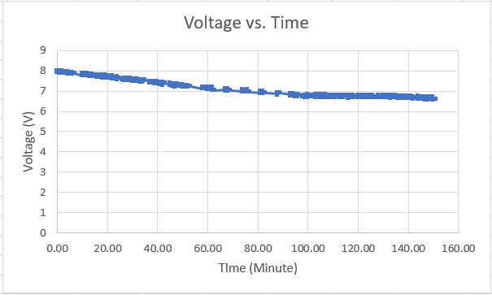
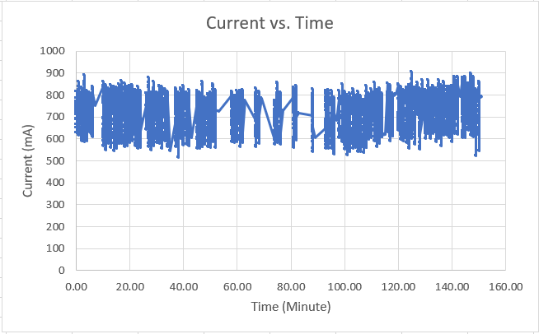
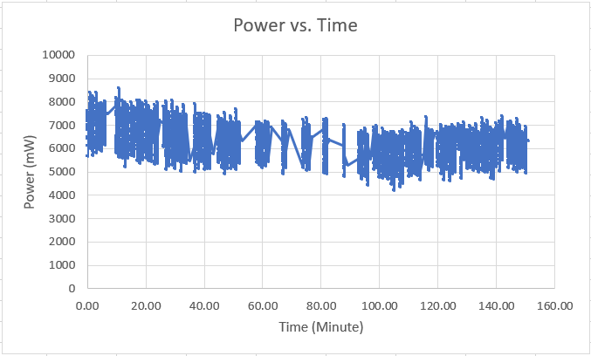
Voltage, Current, Power

Slide 29
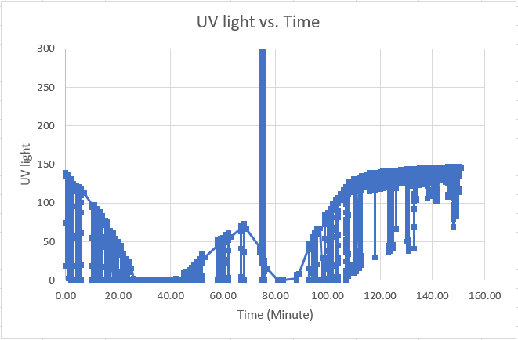
UV light
UV light is measured in microwatts of ultraviolet radiation per lumen of visible light (μW/l)

Slide 30
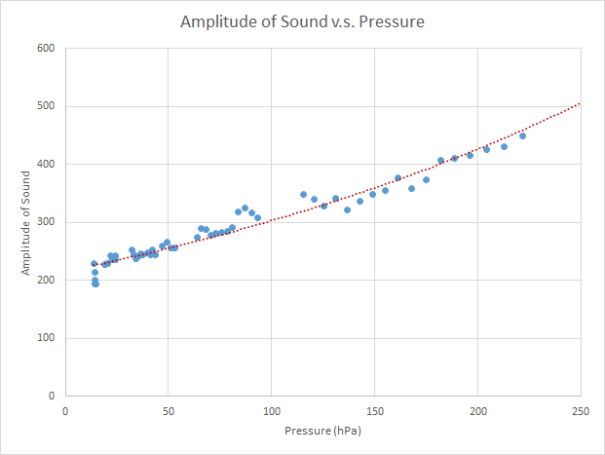
Sound Test

Slide 31
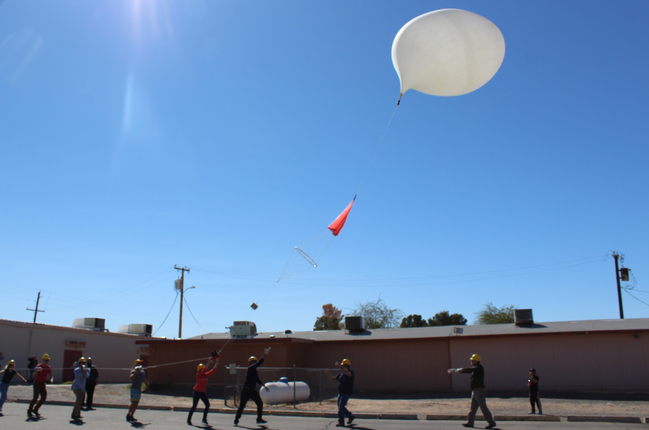
Conclusion
Issues:
360fly
Did not record properly
External Temperature
Analog sensor did not work
UV light
Unknown spikes in data

Slide 32
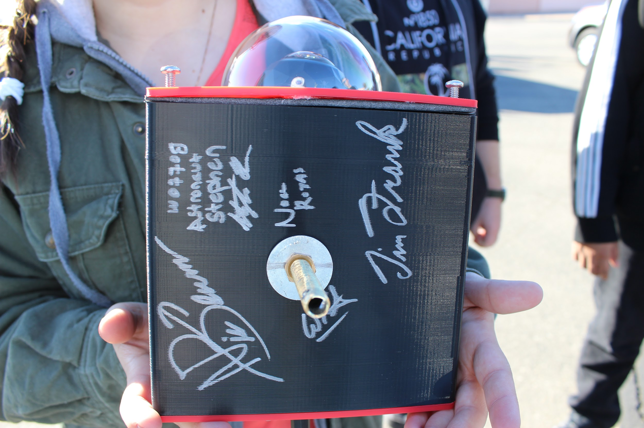
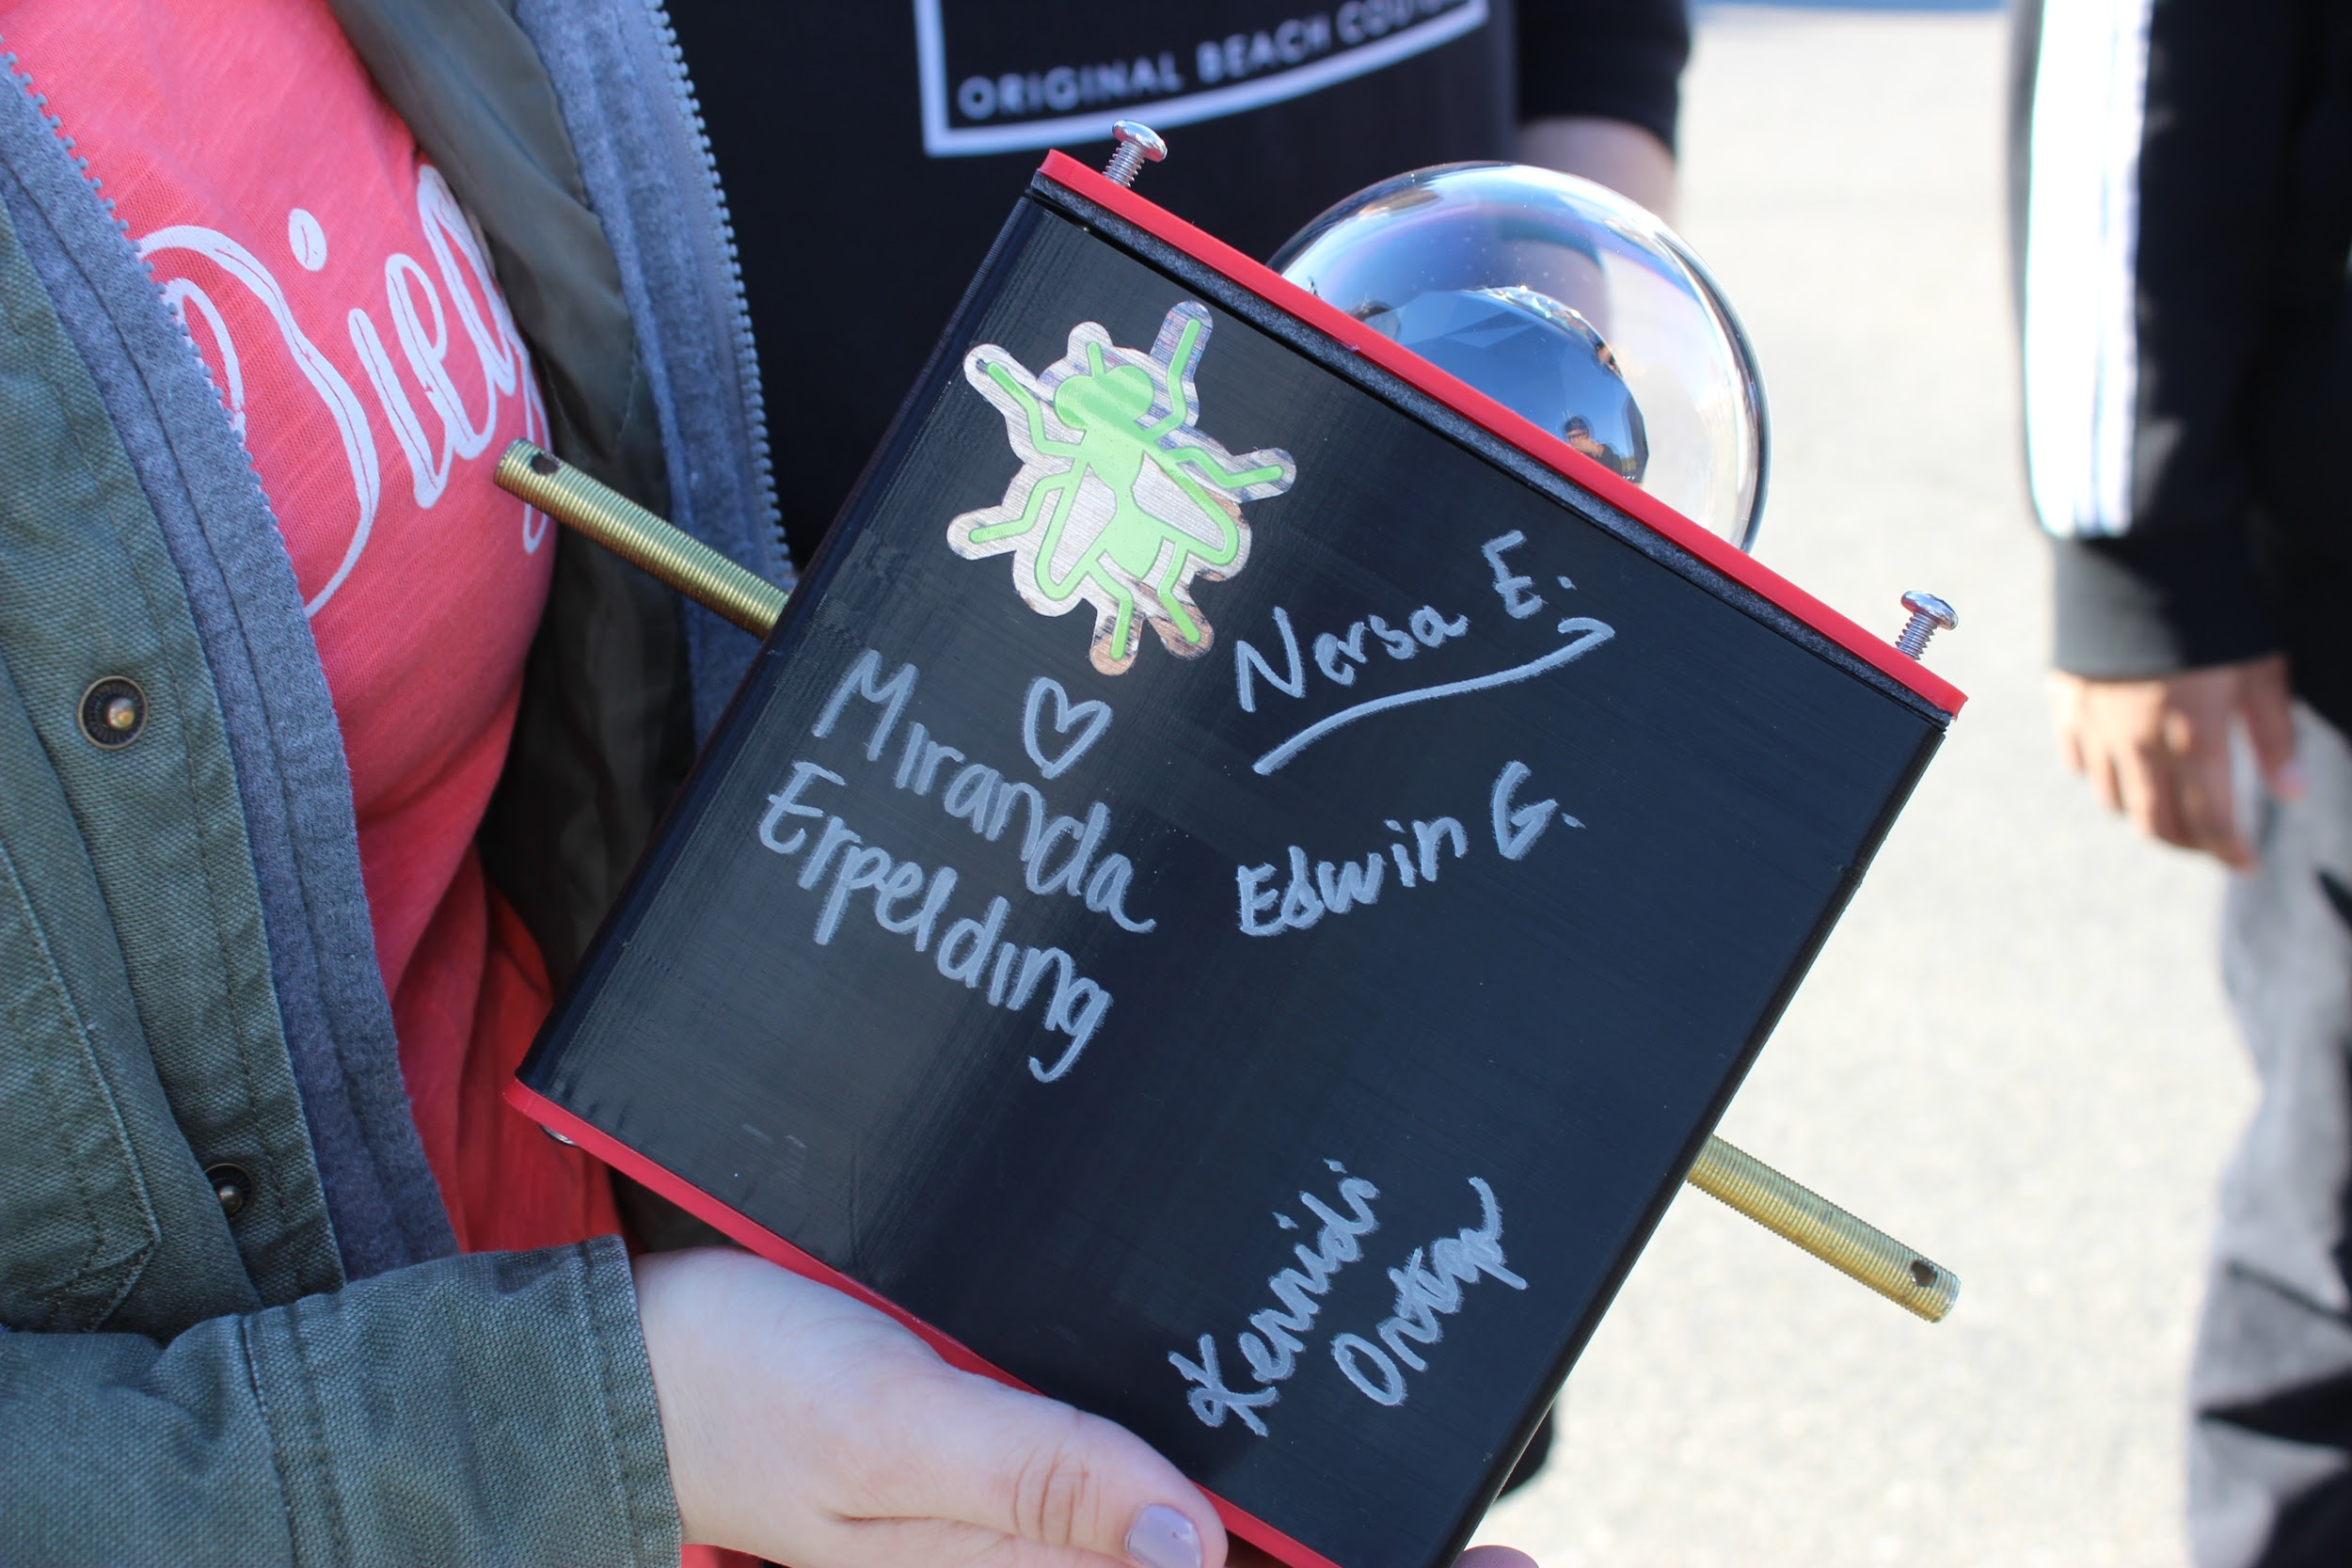
Conclusion (con’t.)
Successes:
Made a 3D printed payload
Used satellite communication to receive live data during flight
Gathered sensor data throughout flight
Videoed burst of balloon
Sound experiment verified sound transmission throughout flight

Slide 33
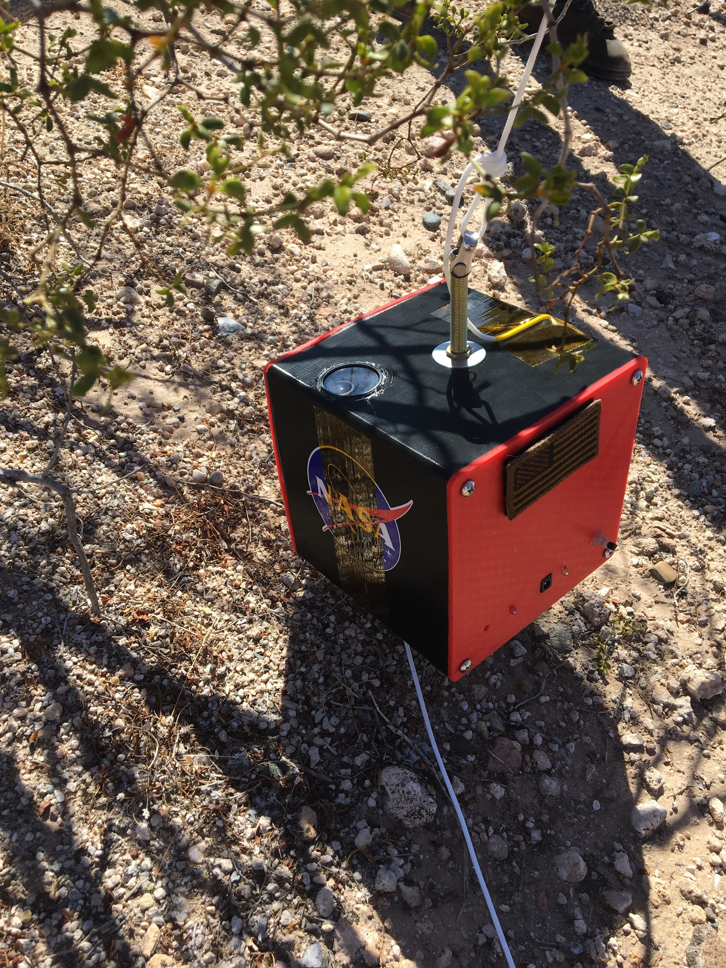
Future Plans
Use a Second RockBlock modem to have communication between the van and the payload
Using a second Arduino for transmission only
Create set of instructions for:
RockBlock Modem
360Fly Camera
3D printed payload using SolidWorks

Slide 34
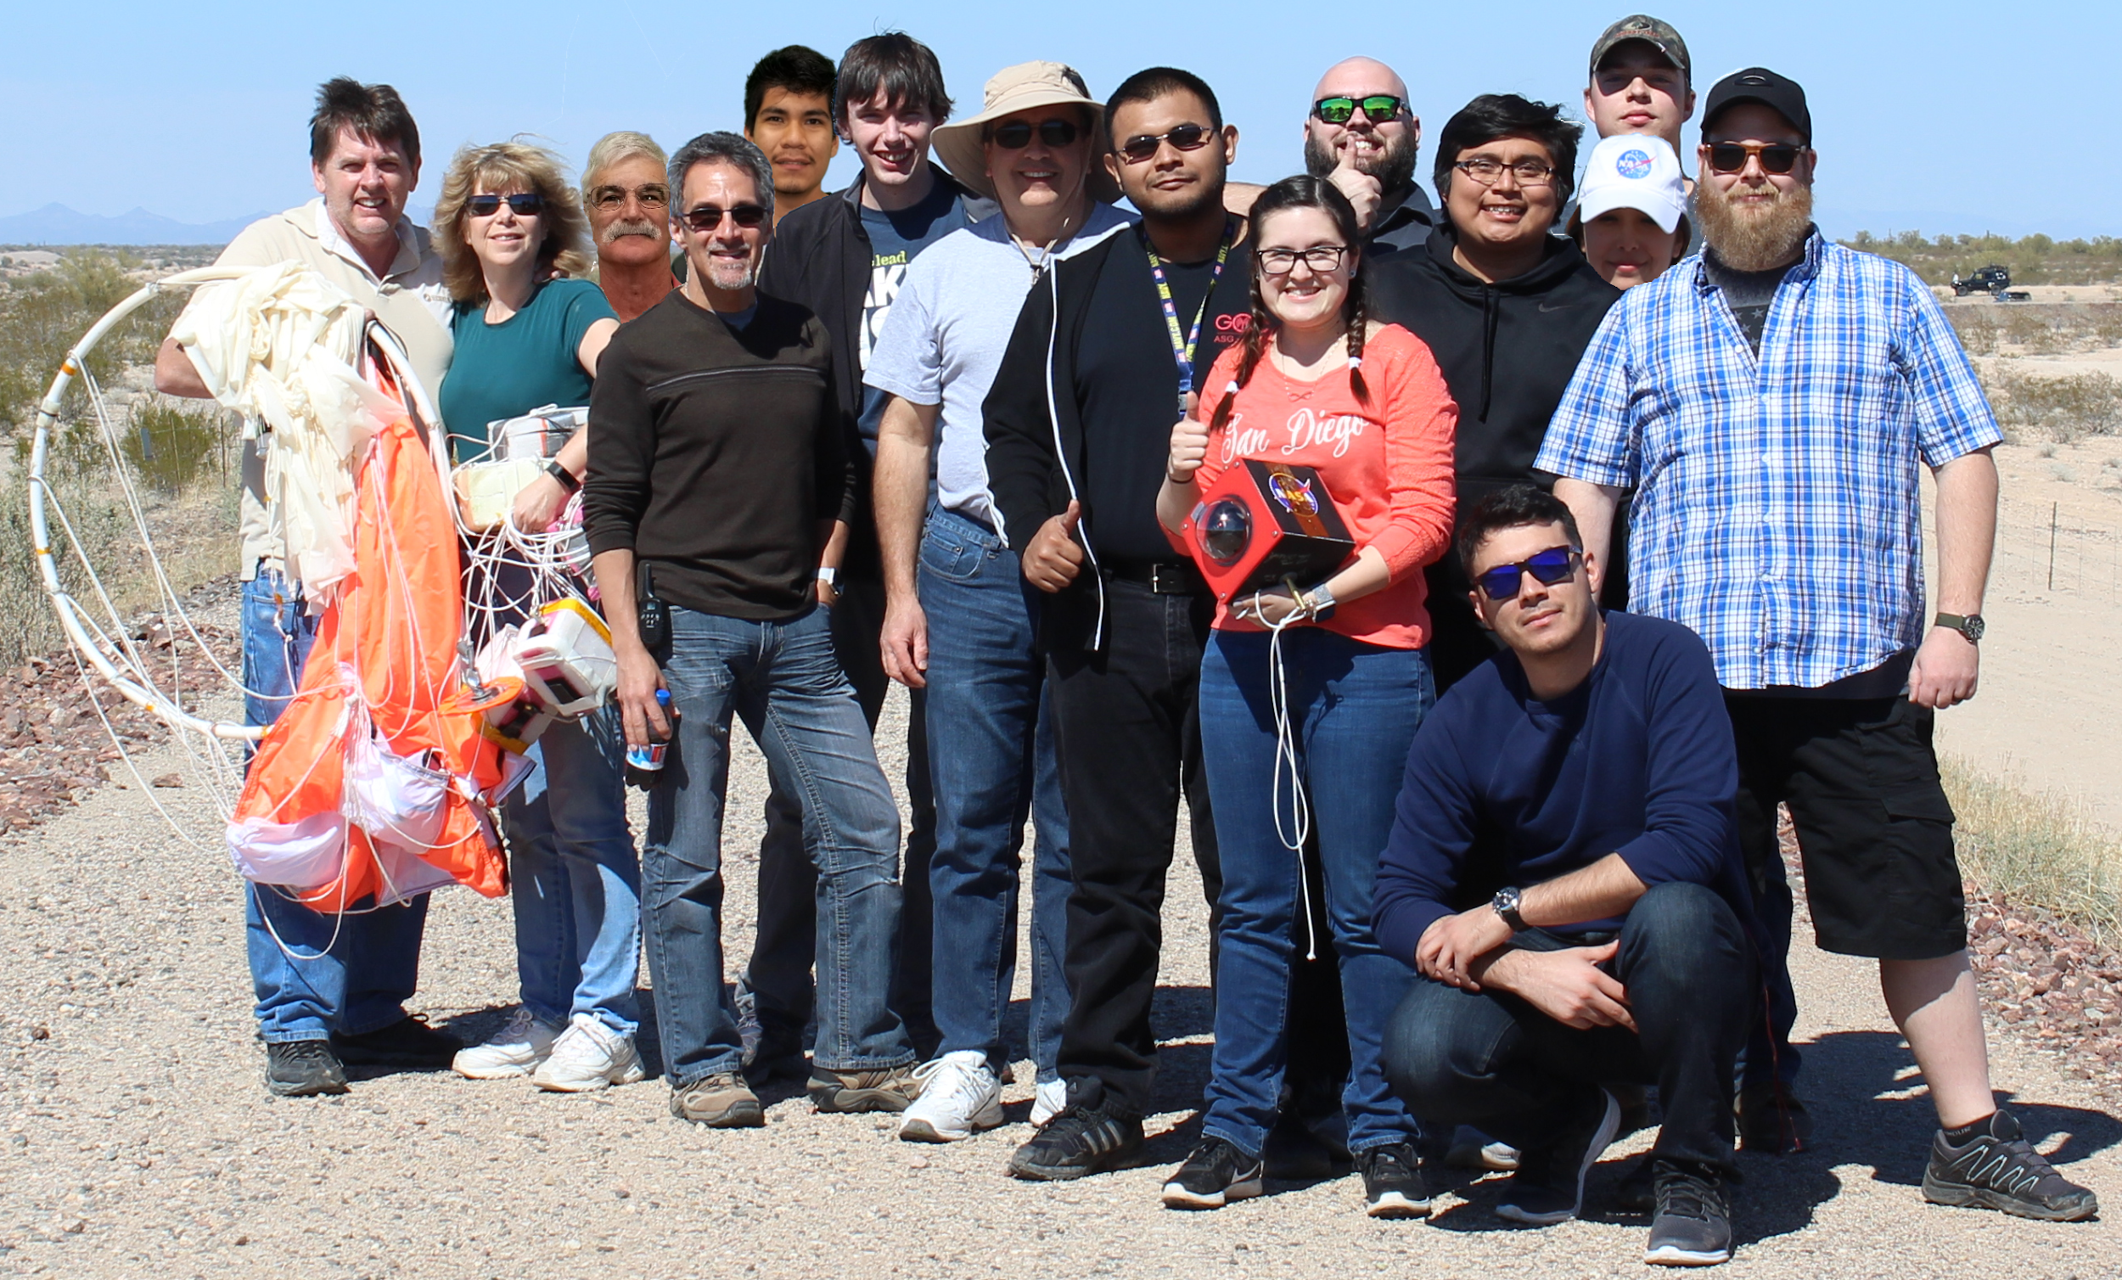


Special Thanks
ANSR Team
Susan Brew
Dr. Tim Frank
Rick Sparber
William Stein

